Slide 1
On re-using this presentation
The purpose of this presentation is to show that cognitive is real and alive. In order to do so, it works best to show people live applications. This requires you to switch between the presentation and a browser.
Open all the links in your browser of choice and follow the instructions at http://lifehacker.com/save-sets-of-multiple-tabs-to-launch-later-in-the-bookm-1453967463
Put all the bookmarks in one bookmark folder and right click the folder “open all” for quick access
https://www.1800flowers.com/gwyn-1800flowers?flws_rd=1
https://www.macys.com/ce/splash/store-help-chat/index
https://www.hrblock.com/lp/fy17/hrblock-and-watson.html
http://ecc.ibm.com/case-study/us-en/ECCF-WUC12550USEN
http://ecc.ibm.com/case-study/us-en/ECCF-RAC14387USEN
http://www.findnewroads.com/
https://www.thenorthface.com/xps
https://educateme.tdameritrade.com/
https://www.rarecarat.com/
https://watsonads.com/
https://www.ibmchefwatson.com/
https://visual-recognition-demo.mybluemix.net/
https://conversation-demo.mybluemix.net/
https://product-line-prediction-alexj42-855.mybluemix.net/

Slide 2
The key to Cognitive Business is putting data to work
Dr. Olav Laudy
Chief data scientist, IBM Analytics, Asia-pacific

Slide 3

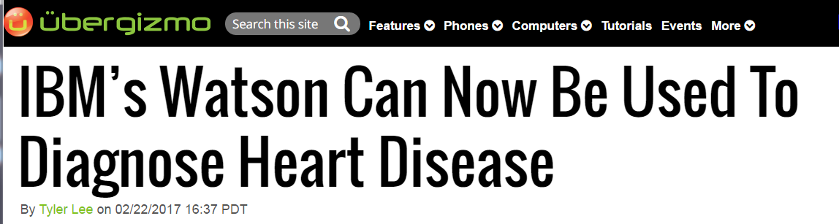
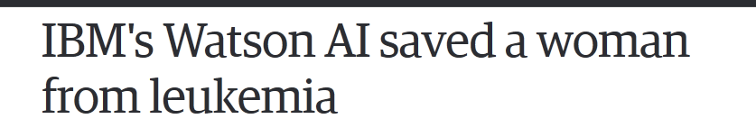
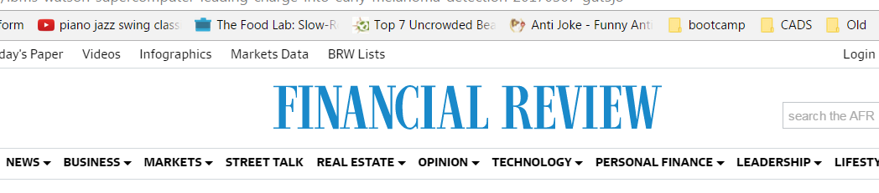
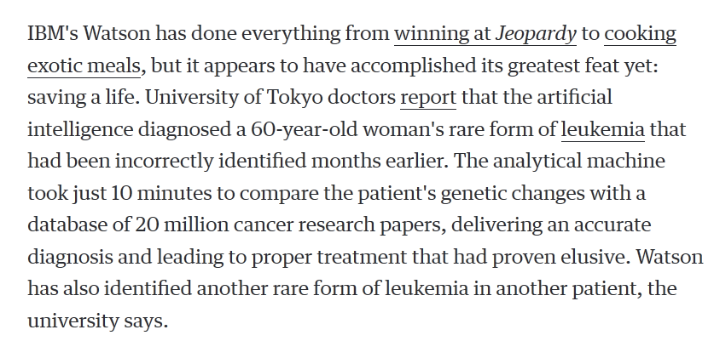

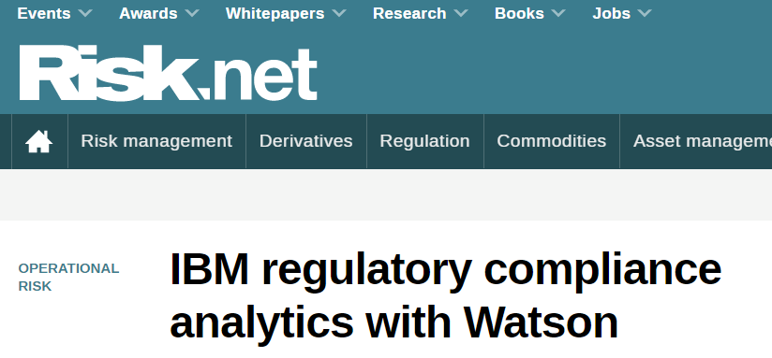
22 February 2017
7 August 2016
Dr. Olav Laudy
Putting data to work
Dr. Olav Laudy
Putting data to work
10 March 2017
Dr. Olav Laudy
Putting data to work
Dr. Olav Laudy
Putting data to work
Dr. Olav Laudy
Putting data to work
13 March 2017
Dr. Olav Laudy
Putting data to work
Dr. Olav Laudy
Putting data to work

Slide 4
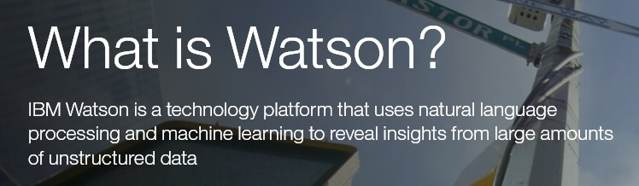
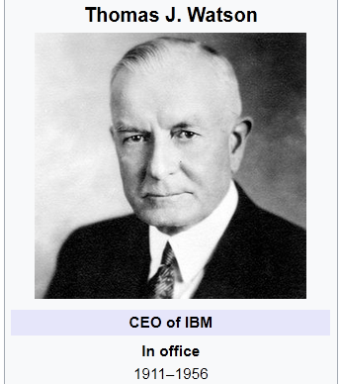
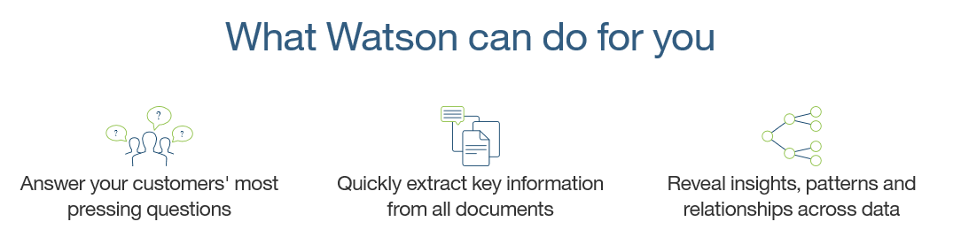
The cognitive technology of IBM is called Watson
Dr. Olav Laudy
Putting data to work
Dr. Olav Laudy
Putting data to work
Dr. Olav Laudy
Putting data to work
Dr. Olav Laudy
Putting data to work
Dr. Olav Laudy
Putting data to work
Dr. Olav Laudy
Putting data to work
Dr. Olav Laudy
Putting data to work

Slide 5
10 ways you may have already used IBM Watson
Technology must be like oxygen: ubiquitous, necessary and invisible.
Appeared on http://www.topbots.com/10-major-fortune-500-brands-using-ibm-watson/

Slide 6
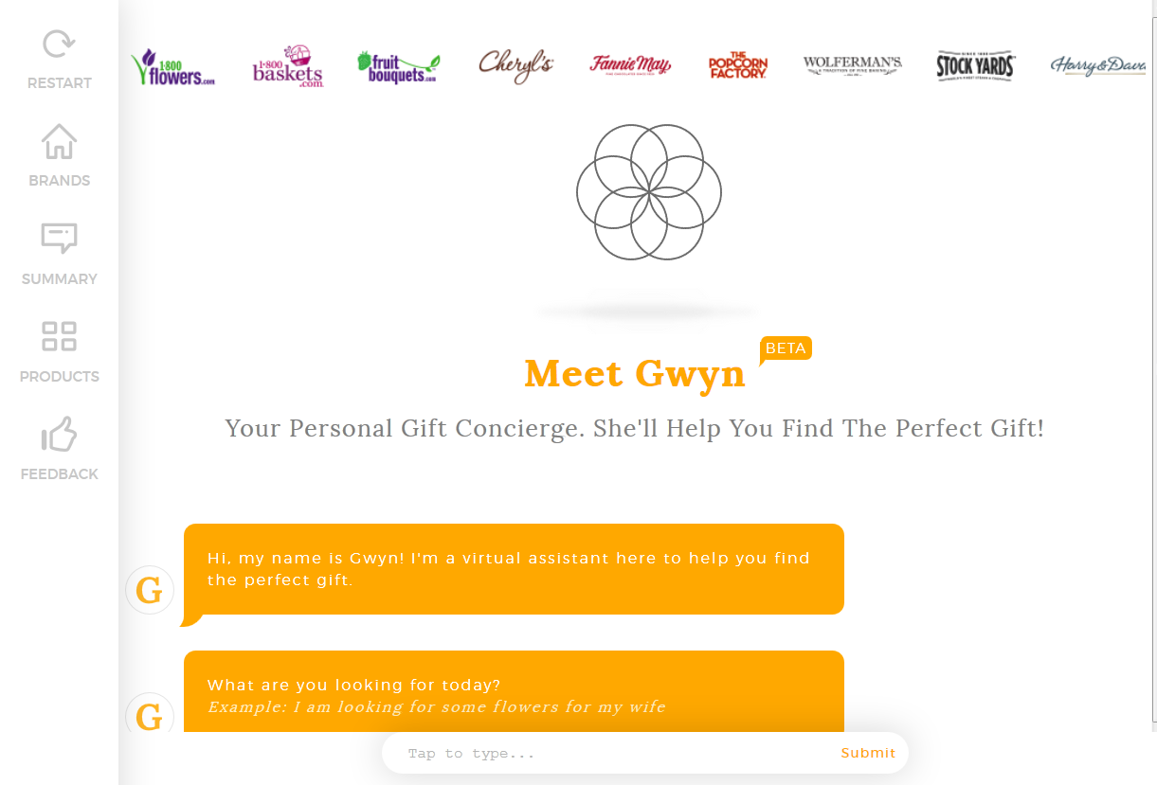
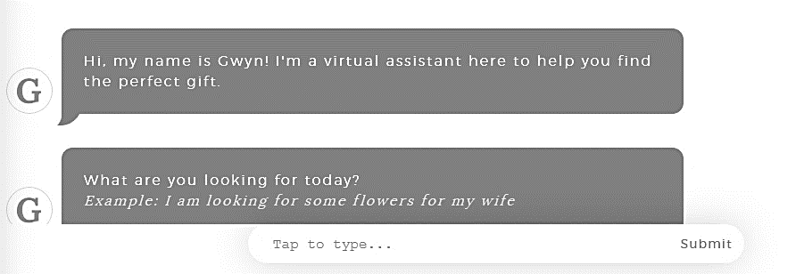
1-800-Flowers
1-800-Flowers features a handy virtual assistant named Gwyn who lives on the website and helps you shop for gifts across all of company’s retail brands, including Fruit Bouquets and Popcorn Factory.
Dr. Olav Laudy
Putting data to work
Dr. Olav Laudy
Putting data to work
Dr. Olav Laudy
Putting data to work
Dr. Olav Laudy
Putting data to work
Dr. Olav Laudy
Putting data to work
Dr. Olav Laudy
Putting data to work
Dr. Olav Laudy
Putting data to work
https://www.1800flowers.com/gwyn-1800flowers?flws_rd=1

Slide 7
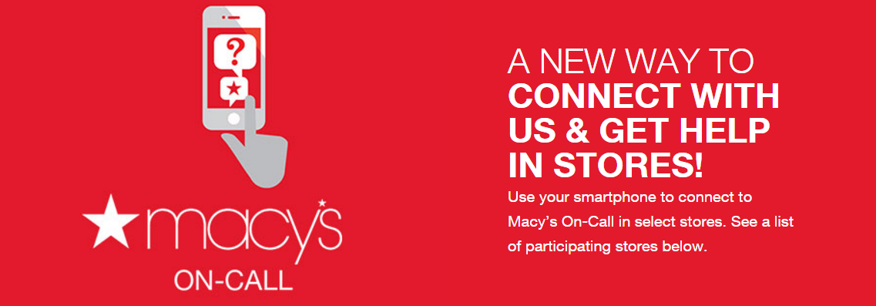
Dr. Olav Laudy
Putting data to work
Dr. Olav Laudy
Putting data to work
Dr. Olav Laudy
Putting data to work
Dr. Olav Laudy
Putting data to work
https://www.macys.com/ce/splash/store-help-chat/index
Macy’s
Most companies struggle to provide consistent, excellent customer service. The struggle is even more real when you’re the largest US department store chain, operating over 700 locations where customers shop for hundreds of thousands of different products.
To help address the relentless flow of consumer inquiries, Macy’s leverages Watson to power OnCall, a support bot currently live at several store locations.
Dr. Olav Laudy
Putting data to work
Dr. Olav Laudy
Putting data to work
Dr. Olav Laudy
Putting data to work

Slide 8

H&R Block
“I love doing taxes,” said no one ever, not even tax preparers. To streamline the process, H&R Block integrated Watson to improve client communications, identify deduction opportunities, and optimize your filing strategy. Unlike a human, Watson can analyze all 74,000 pages of tax code, keep up with changes in the law, and calculate the best approach for saving money.
Dr. Olav Laudy
Putting data to work
Dr. Olav Laudy
Putting data to work
Dr. Olav Laudy
Putting data to work
Dr. Olav Laudy
Putting data to work
Dr. Olav Laudy
Putting data to work
Dr. Olav Laudy
Putting data to work
Dr. Olav Laudy
Putting data to work
https://www.hrblock.com/lp/fy17/hrblock-and-watson.html

Slide 9
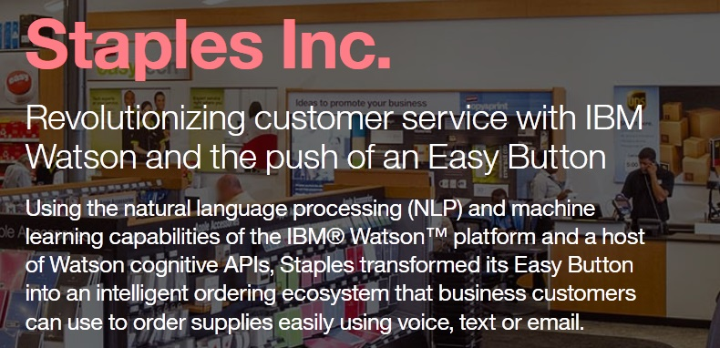
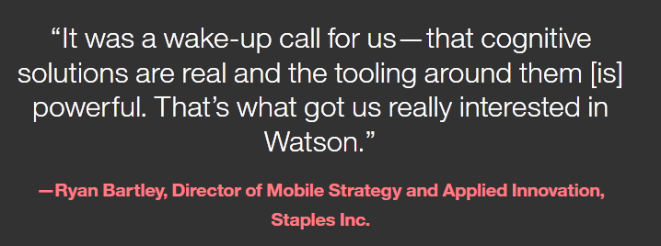
Dr. Olav Laudy
Putting data to work
Dr. Olav Laudy
Putting data to work
Dr. Olav Laudy
Putting data to work
Dr. Olav Laudy
Putting data to work
http://ecc.ibm.com/case-study/us-en/ECCF-WUC12550USEN
Dr. Olav Laudy
Putting data to work
Staples
Constantly re-ordering office supplies for your team is not fun, which is why Staples invented their recognizable red Easy button. Install this button in your office and simply say “Order me more blue pens” and Watson will process your spoken input and get your order under way.
Dr. Olav Laudy
Putting data to work
Dr. Olav Laudy
Putting data to work

Slide 10
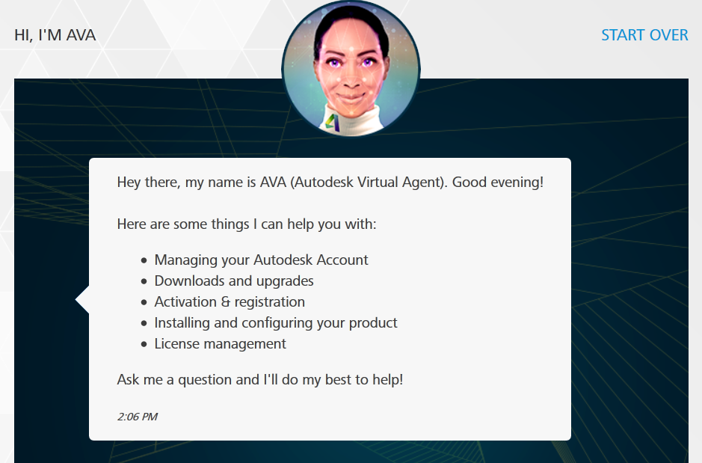
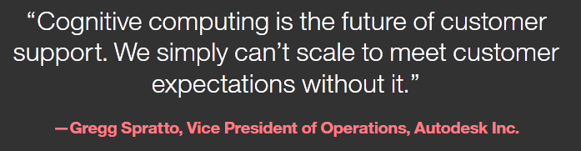
Autodesk
Customer support tickets cost companies a few dollars apiece to tackle, which adds up when you have hundreds of thousands of customers or more.
Even simple support requests, such as switching account information, can be costly when fielded by human experts.
By building a customer support bot named Ava with Watson technologies, Autodesk was able to reduce support costs by 90% and resolve issues in minutes and not hours.
Dr. Olav Laudy
Putting data to work
Dr. Olav Laudy
Putting data to work
Dr. Olav Laudy
Putting data to work
Dr. Olav Laudy
Putting data to work
Dr. Olav Laudy
Putting data to work
Dr. Olav Laudy
Putting data to work
https://ava.autodesk.com/
Dr. Olav Laudy
Putting data to work
90% reduction:
http://ecc.ibm.com/case-study/us-en/ECCF-RAC14387USEN

Slide 11
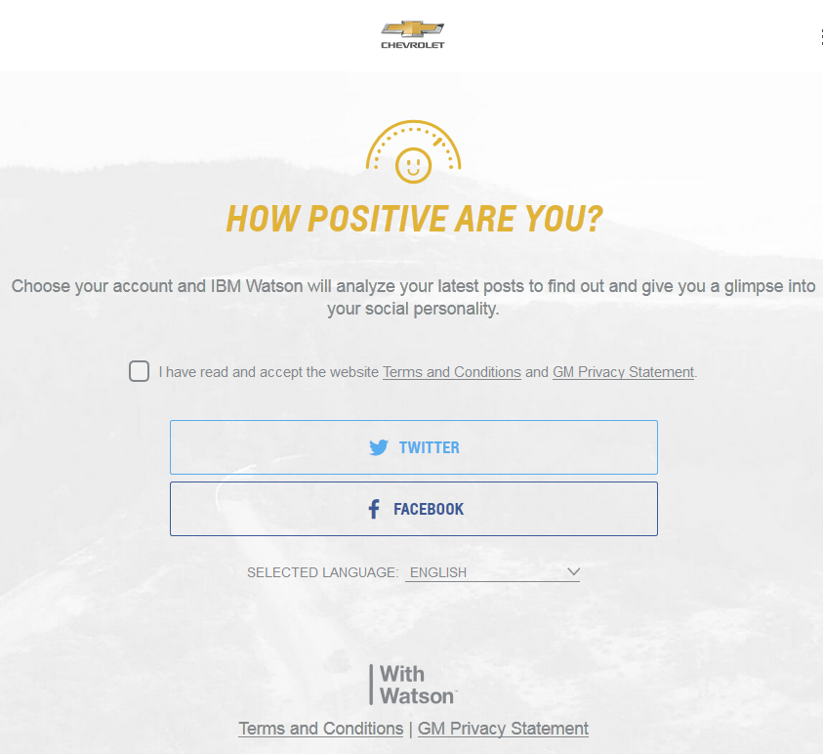
Chevrolet
Chevrolet’s “Find New Roads” campaign is all about promoting positivity and creative thinking when confronted with challenges.
In fact, the brand decided to reward positive consumers by teaming up with Watson to analyze Facebook or Twitter posts and reward the most positive people with free gas.
Dr. Olav Laudy
Putting data to work
Dr. Olav Laudy
Putting data to work
Dr. Olav Laudy
Putting data to work
Dr. Olav Laudy
Putting data to work
Dr. Olav Laudy
Putting data to work
Dr. Olav Laudy
Putting data to work
Dr. Olav Laudy
Putting data to work
http://www.findnewroads.com/

Slide 12
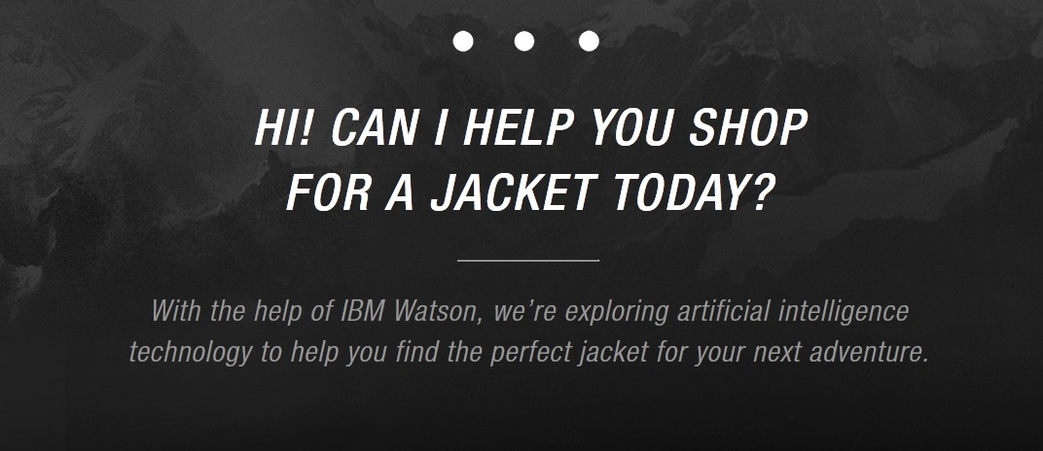

The North Face
When it comes to shopping, one size does NOT fit all, but trying to find the perfect fit for your specific needs can be daunting when you’re culling through hundreds of options.
Dr. Olav Laudy
Putting data to work
Dr. Olav Laudy
Putting data to work
Dr. Olav Laudy
Putting data to work
Dr. Olav Laudy
Putting data to work
Dr. Olav Laudy
Putting data to work
https://www.thenorthface.com/xps
Dr. Olav Laudy
Putting data to work
Partnering with Watson, the North Face is driving forward “cognitive retail” which matches you automatically to the appropriate options based on a quick survey about your intended usage. No longer do you have to decide whether you need a jacket with synthetic, down, or cotton insulation. Just outsource the decisions to Watson.
Dr. Olav Laudy
Putting data to work

Slide 13
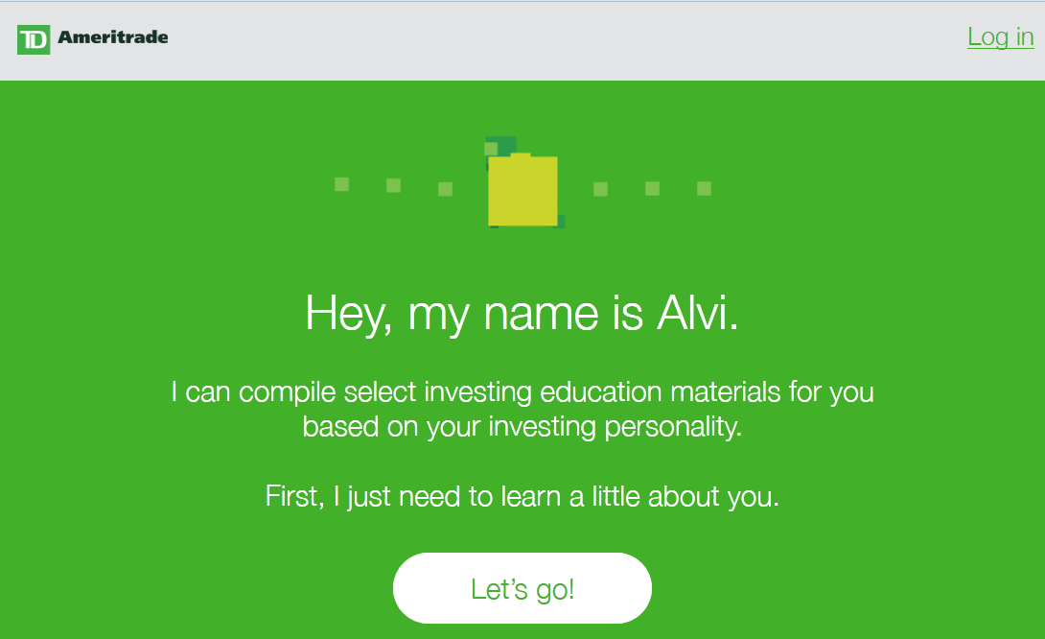
Dr. Olav Laudy
Putting data to work
Dr. Olav Laudy
Putting data to work
TD Ameritrade
Personal finance and investments can be confusing. Alvi, a bot powered by Watson, matches you to the right investment education by learning about your personality.
Dr. Olav Laudy
Putting data to work
Dr. Olav Laudy
Putting data to work
Dr. Olav Laudy
Putting data to work
Dr. Olav Laudy
Putting data to work
https://educateme.tdameritrade.com/
Dr. Olav Laudy
Putting data to work
You can speak to Alvi directly and answer a few personal questions, ask Alvi to deduce your personality by analyzing your social media accounts, or simply pick from four main investor profiles: Cautious Optimist, Trend Spotter, Advice Seeker, and Researcher.

Slide 14
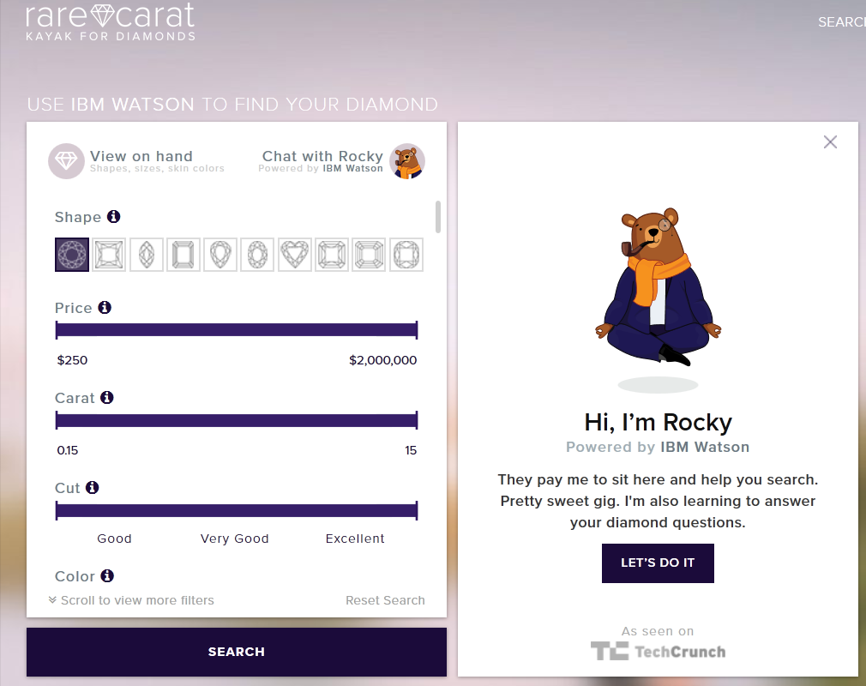
Rare Carat
The average cost of an engagement ring is well over $4,000, so you do not want to buy the wrong one.
While simple options like color and shape might be easy to decide on, you might be confused by how to evaluate qualities like “fluorescence” or certification method.
Luckily, Rocky, a handy bot that lives on the Rare Carat website, leverages Watson to guide you in your important purchasing decision.
Dr. Olav Laudy
Putting data to work
Dr. Olav Laudy
Putting data to work
Dr. Olav Laudy
Putting data to work
Dr. Olav Laudy
Putting data to work
Dr. Olav Laudy
Putting data to work
Dr. Olav Laudy
Putting data to work
Dr. Olav Laudy
Putting data to work
https://www.rarecarat.com/

Slide 15

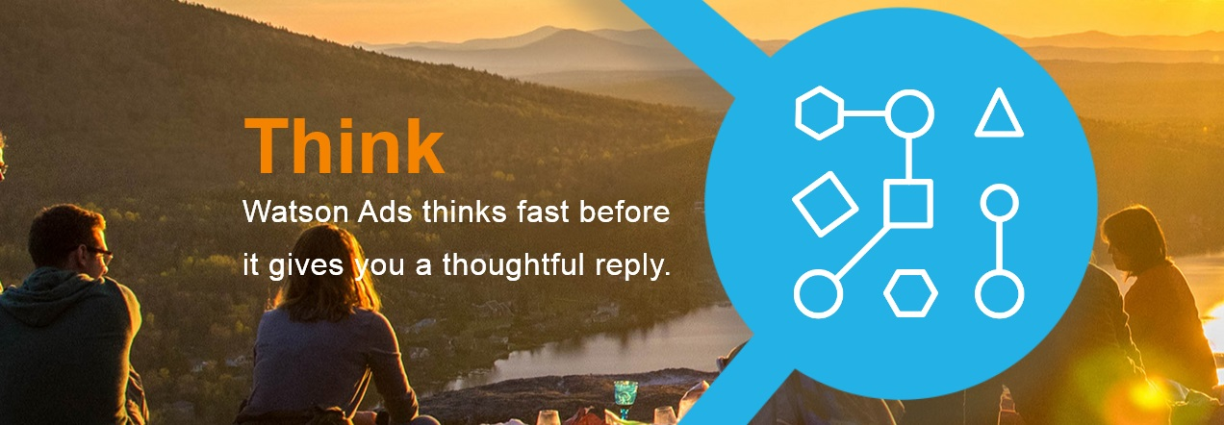


The Weather Company
As the fourth most-used mobile app in the United States, the Weather Company was an attractive acquisition target for IBM, which bought them in October 2015.
Having a popular consumer app has enabled IBM to launch Watson Ads, an interactive ad unit that allows consumers to chat with branded content via voice or text.
Brands like Toyota, Campbell Soup Company, and Unilever have already jumped on board.
Dr. Olav Laudy
Putting data to work
Dr. Olav Laudy
Putting data to work
Dr. Olav Laudy
Putting data to work
Dr. Olav Laudy
Putting data to work
Dr. Olav Laudy
Putting data to work
Dr. Olav Laudy
Putting data to work
Dr. Olav Laudy
Putting data to work
https://watsonads.com/

Slide 16
Watson is in use cross-industry and cross usecase
Dr. Olav Laudy
Putting data to work
Dr. Olav Laudy
Putting data to work
Company | Industry | Use case
Flowers.com | Online retail | Sales assistant
Macy’s | Retail | Customer queries
H&R Block | Financial sector (tax) | Analysis of tax records
Stables | Retail | Order fulfillment
Autodesk | Software industry | Customer support
Chevrolet | Automotive | Marketing campaign (sentiment analysis)
The North Face | Retail | Sales assistant
TD Ameritrade | Finance (investment) | Product recommendation (personality based)
Rare Caret | Retail | Sales assistant
The Weather Company | IT company | Interactive advertisements
Dr. Olav Laudy
Putting data to work
Dr. Olav Laudy
Putting data to work
Dr. Olav Laudy
Putting data to work
Dr. Olav Laudy
Putting data to work
Dr. Olav Laudy
Putting data to work
Follow the links in the slides try them out yourself!

Slide 17
SEPARATING FACT FROM FICTON
Today’s science fiction is tomorrows fact

Slide 18
Myth: Provide <any> data to Watson and within minutes Watson can answer any question about the data
Fact
System needs to be configured and trained by humans.
Data provided needs to be of good quality and in a specific format
Questions - answer pairs. Answer can be in documents
Benefit
The system is very strong at generalizing provided question-answer pairs.
Teach: “What is the benefit of Vitamin C”
Will subsequently understand: “What is the benefit of Vitamin B”
Depending on the complexity of the problem, more training or data may be required.

Slide 19
Myth: Watson ‘undestands’ and ‘reasons’
Fact
Understanding is a human capability.
The question of whether machines can understand is about as relevant as the question of whether submarines can swim.
Reasoning is a logical follow-up of arguments and it has not yet been shown that computers are capable of logical deduction with natural language.
Peter and Mary are in a room. Peter walks out of the room. Where is Mary?
Benefit
The system applies patterns found in historic data in a time forward manner.
Multi step processes are human programmed. – and very useful!!
“I understand you want to order a pizza; what topping do you want?

Slide 20
Myth: Watson <by itself> can hold full conversations
Fact
Current state of technology is doesn’t have the capability for unscripted conversations.
Humans can easily get the impression of a conversation if the system provides relevant answers to questions
Benefit
Many transactional processes are structured enough such that the conversation can capture all aspects of the transaction.
90% of time is spend on 10% of (repeated ) questions of customers.
Automate those 10% of questions to free up 90% of time that can be dedicated to the complex cases.

Slide 21
Myth: You can only use Watson on unstructured data
Fact
Cognitive capabilities are an extension of analytics.
Smarter machine learning techniques, using language or not, are also cognitive
Natural language processing doesn’t ‘compute’
A chat bot providing recommendations is a combination of a conversation service and a recommendation system.
Benefit
Cognitive can be positioned as enhancement of current analytics initiatives.
Componentized systems allows for better management
Improve the chat bot; improve the recommendation. Not: improve the recommendations by improving the chatbot.

Slide 22
Myth: Watson is only about conversation
Fact
There are 100+ Watson APIs with a wealth of functionality
Conversation is a common usage pattern, in combination with
Sentiment analysis (think Chevrolet)
Personality insights (think TD Ameritrade)
Weather patterns
News retrieval
Trade off analytics
Etc.
Benefit
Merge and match any API with ease
Creativity is a wild mind and a disciplined eye

Slide 23
So,… Watson is not creative Watson is all pre-programmed Watson is …
No! patterns in data + math can be used in remarkable ways

Slide 24
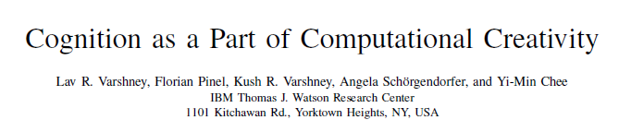
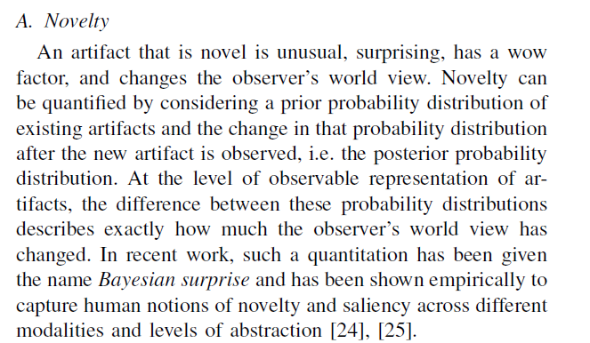
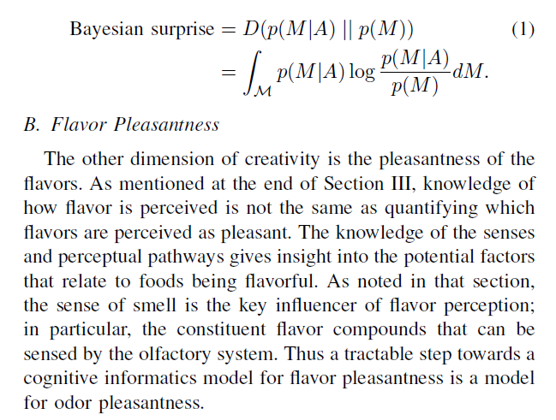

Slide 25
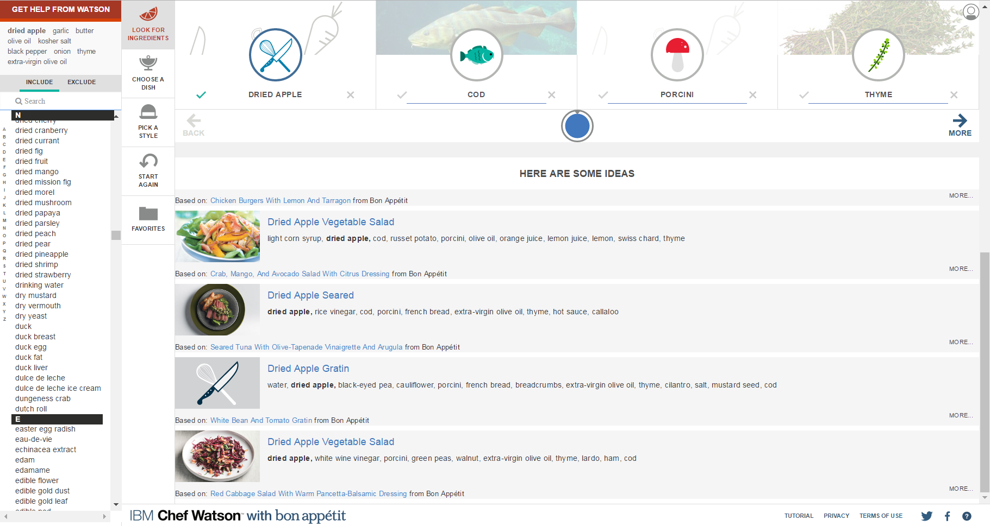
Dr. Olav Laudy
Putting data to work
Dr. Olav Laudy
Putting data to work
Dr. Olav Laudy
Putting data to work
Dr. Olav Laudy
Putting data to work
Dr. Olav Laudy
Putting data to work
Dr. Olav Laudy
Putting data to work
Dr. Olav Laudy
Putting data to work
https://www.ibmchefwatson.com/

Slide 26
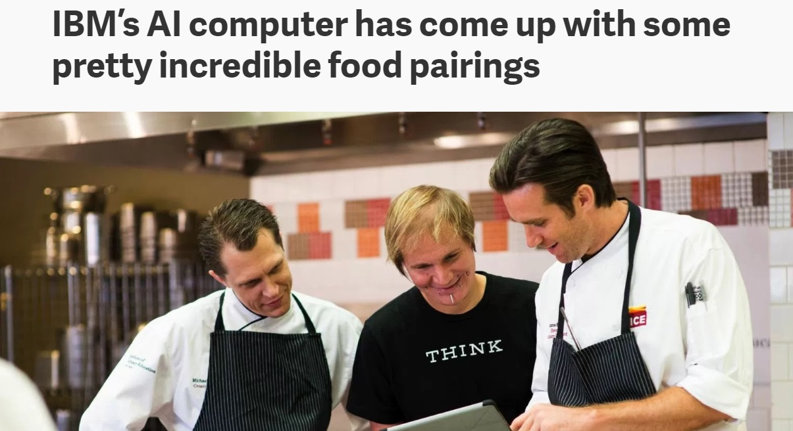
Dr. Olav Laudy
Putting data to work
Dr. Olav Laudy
Putting data to work
Belgian bacon pudding, a desert containing dried porcini mushrooms
Vietnamese apple kebab, with the vaunted mushroom-and-strawberry pairing
Portuguese lobster roll, with appetizing “saffron fluid gel”
Hoof-n-Honey ale, with veal stock
Thai-Jewish chicken, with potato latkes and rice balls
The shrimp cocktail, which is a beverage with actual shrimp in it
Kenyan Brussels spouts, with cardamom
Dr. Olav Laudy
Putting data to work
Dr. Olav Laudy
Putting data to work
Dr. Olav Laudy
Putting data to work
Dr. Olav Laudy
Putting data to work
Dr. Olav Laudy
Putting data to work

Slide 27
Understanding Watson in terms of its components
A look behind the scenes

Slide 28
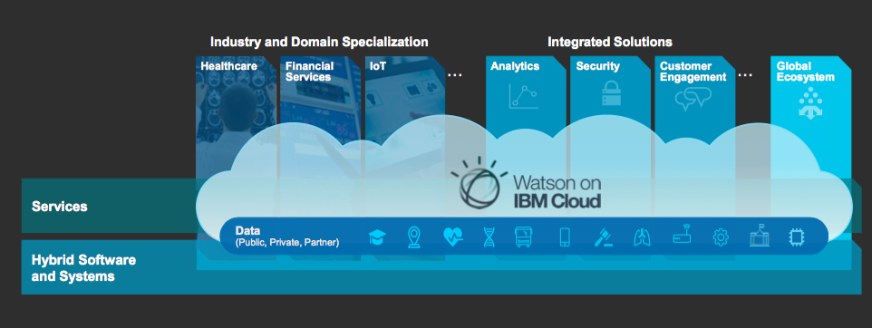

The Watson Data Platform making data simple and accessible to all

Slide 29
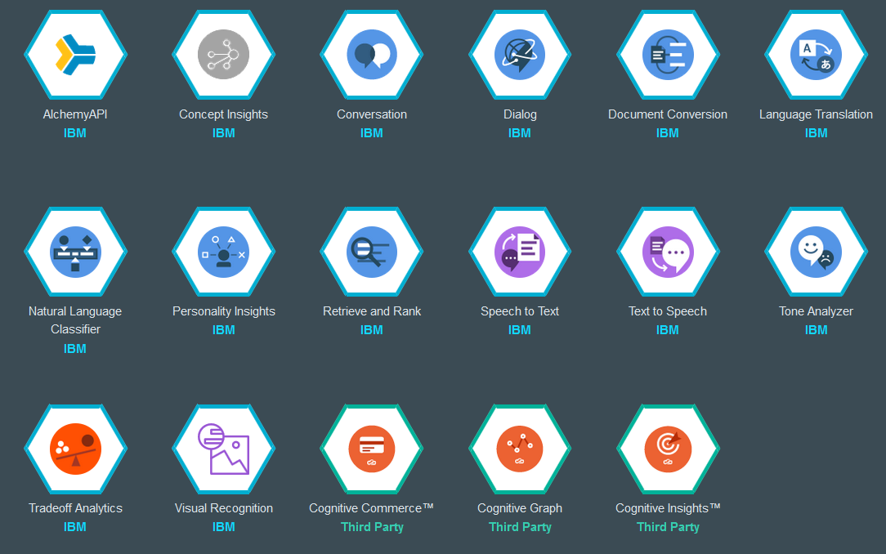
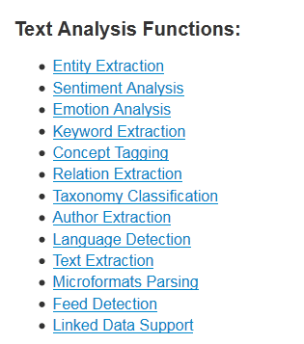
The Watson Data Platform enables organizations and developers to quickly and easily create, deploy, and manage applications on the cloud.
Dr. Olav Laudy
Putting data to work
Dr. Olav Laudy
Putting data to work
Examples of cognitive APIs
Dr. Olav Laudy
Putting data to work
Dr. Olav Laudy
Putting data to work
Dr. Olav Laudy
Putting data to work
Dr. Olav Laudy
Putting data to work
Dr. Olav Laudy
Putting data to work

Slide 30
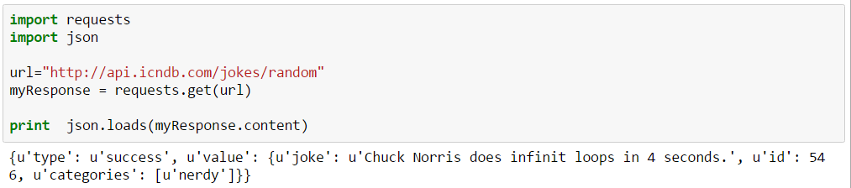
What is an API or web service?
A webpage that provides/returns information in a structured way to it can be processed further.
Example:

Slide 31
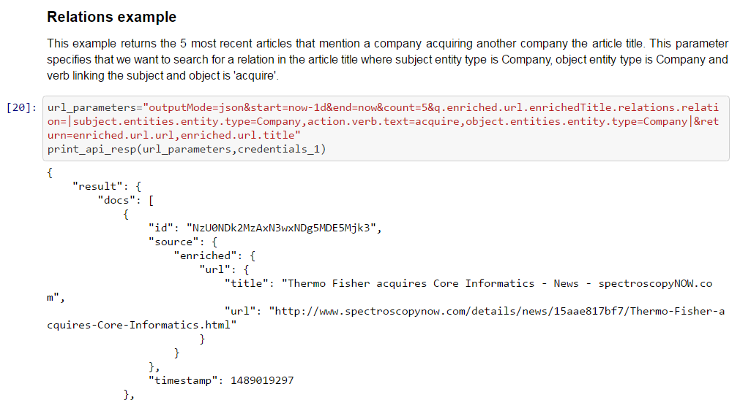
Return the 5 most recent articles that mention a company acquiring another company the article title.
subject entity type “Company”, object entity type is “Company”
Verb linking the subject and object is 'acquire'
Look at the work ‘behind the scenes’:
Not just retrieving news articles, but actively decomposing the language so a vast amount of intelligent queries van be formed.
Watson News API

Slide 32
























This API-centric, as-a-Service delivery is disrupting the consumption of business services as Cloud disrupted the IT consumption model
Integrated Business Functions
Business Solutions
API-centric Business Services
Packaged Applications
SOA Based Custom Development
Long Project Planning and Development
 | As-a-service delivery
 | Composable Web
 | Short Innovation Lifecycle
API
API
API
API
API
API
Infrastructure
Dedicated IT
Cloud
Dedicated IT investments
Contracts & Negotiations
People & Hand-offs
 | Pay-per-use and other models
 | Standard Contracts
 | DevOps

Slide 33
So, now I need to hire API programmers? Teach them data science?

Slide 34





IBM enables collaboration between vertical skillsets
Data Engineering
Data Science
Business Analysis
App Development
Experiences
task-specific, collaborative
Data and Analytics Services
comprehensive
open • intelligent • hybrid

Slide 35



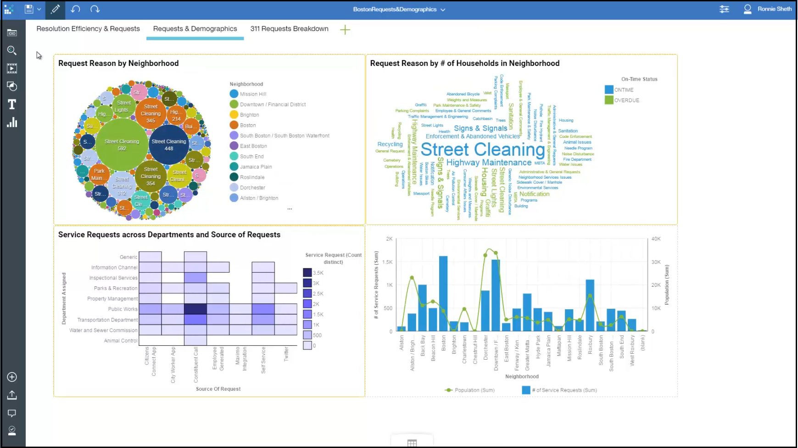
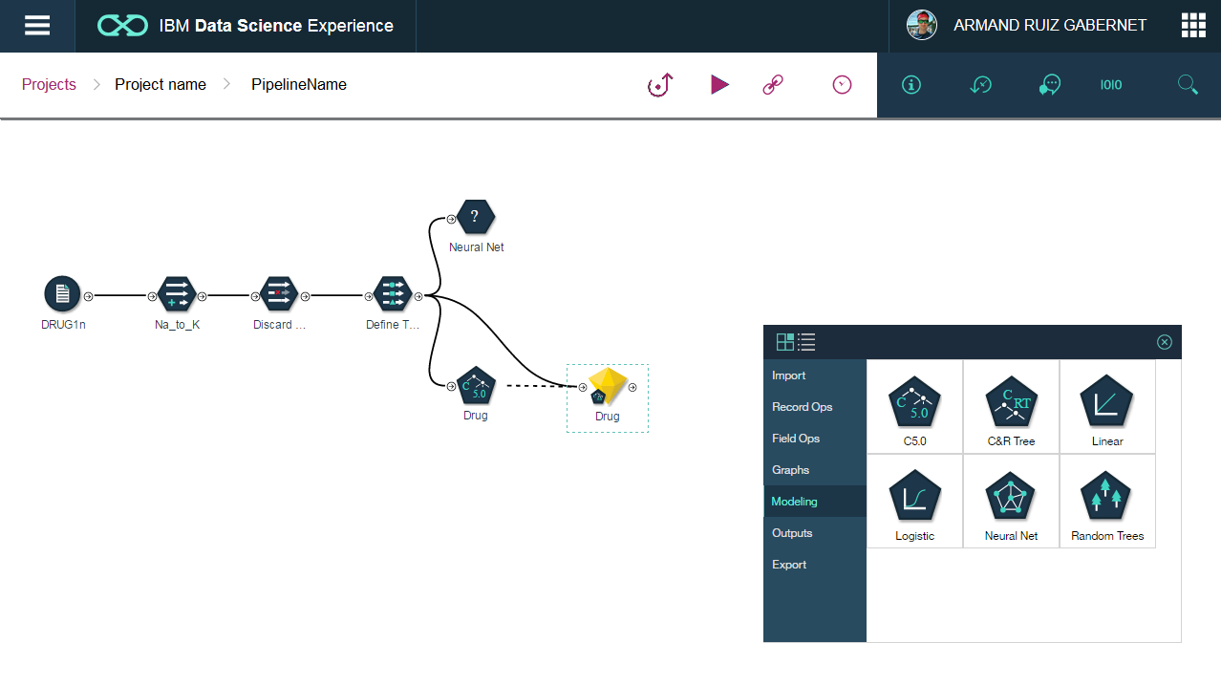
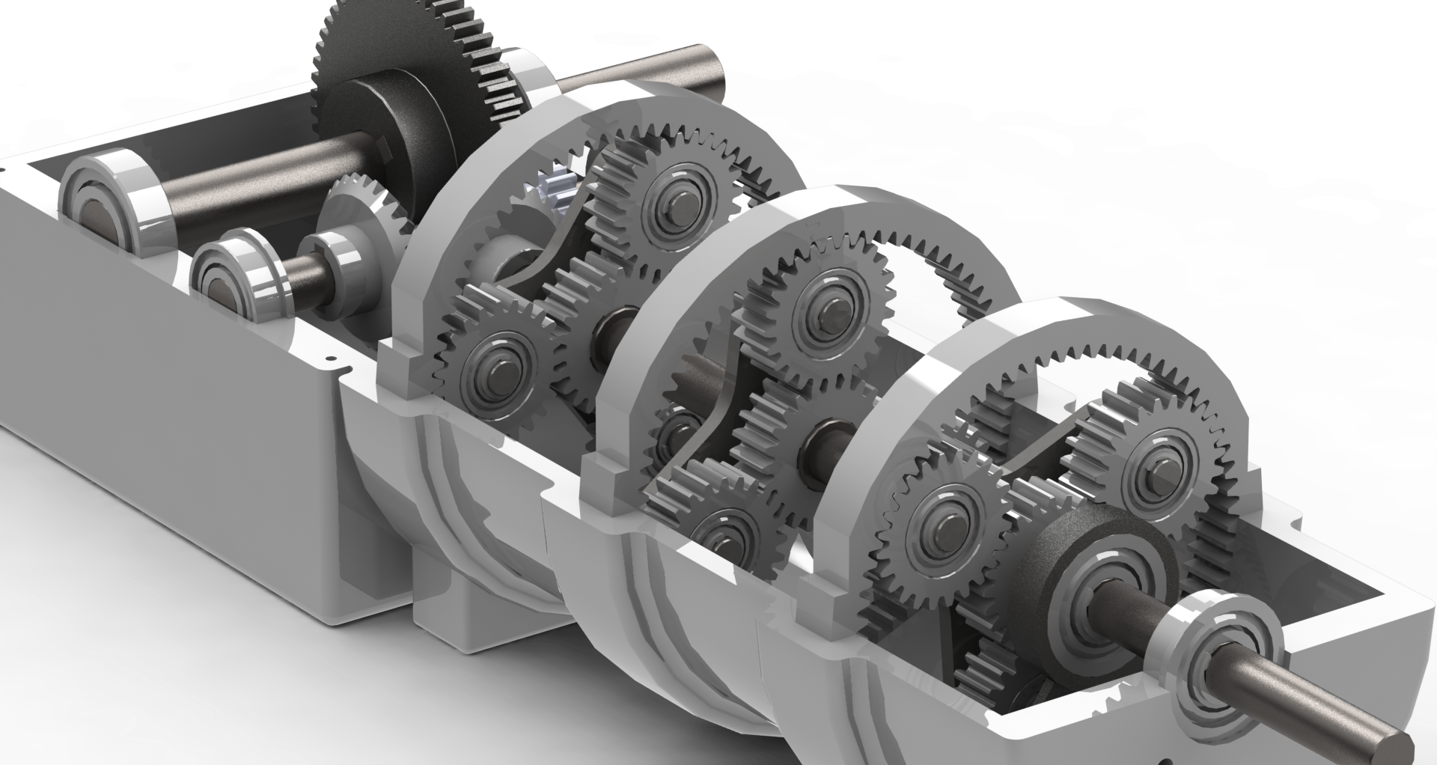
Process view

Slide 36

Role view
Data Engineering
Dr. Olav Laudy
Putting data to work
Dr. Olav Laudy
Putting data to work
Business Analysis
Big Data expert
Operational data pipe lines
Data wrangling
Business expert
Citizen analyst
Insight generation
Dr. Olav Laudy
Putting data to work
Dr. Olav Laudy
Putting data to work
Machine learning expert
Rapid analytics development
Use case preparation
Dr. Olav Laudy
Putting data to work
Programming expert
DevOps
Security and scale
Dr. Olav Laudy
Putting data to work
Dr. Olav Laudy
Putting data to work
Data Science
App Development

Slide 37






Product view
Dr. Olav Laudy
Putting data to work
Data Engineering
Dr. Olav Laudy
Putting data to work
Business Analysis
Dr. Olav Laudy
Putting data to work
Dr. Olav Laudy
Putting data to work
Dr. Olav Laudy
Putting data to work
Data Science
App Development

Slide 38

The distance between your goals and reality is called action
Let’s talk

Slide 39
EXAMPLES OF COGNITIVE APPLICATIONS WITH A PEEK UNDER THE HOOD

Slide 40
Engagement Survey Sentiment Analysis
A simple cognitive example

Slide 41
Solution overview
Description
Engagement Survey Sentiment Analysis is a solution that provides a comprehensive analysis on the sentiment expressed by employees on an internal survey: collected data is anonymous.
Expected Benefits
Gaining access into previously unavailable insights concerning internal climate. It helps us knowing how people think about different topics, avoiding manual workload and avoid bias.
Targeted Audience
Senior Leaders

Slide 42






Fully cloud based Solution architecture
Alchemy API
performs the language analysis
IBM Forms Experience builder generates survey forms
Node Red
transports the data
Watson Analytics
is the presentation front end
IBM Cloudant
stores unstructured (JSON) data
DashDB
stores the data persistently

Slide 43
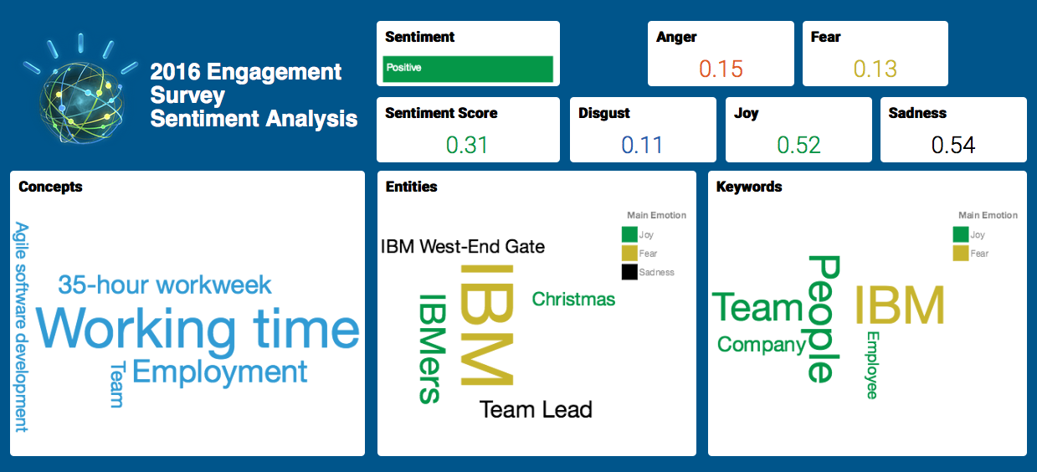
Solution Front-end

Slide 44
Facebook Engagement Insights
A slightly more complex example

Slide 45
Solution overview
Description
Facebook Engagement Insights is a solution that provides a comprehensive analysis on the performance of Facebook Public Pages, including insights on user engagement, content optimization and emotions, while enabling customizable comparison among competitors and visualization of historical trends.
Expected Benefits
Higher performance of Facebook campaigns, resulting in enhanced ability to attract talent. Higher productivity due to reduced workloads related to analysis of Facebook campaigns. Enhanced Digital Analytics consulting services.
Targeted Audience
HR Executives & Senior Leaders, Community Managers, Digital Analytics Consultants

Slide 46


Fully cloud based Solution architecture
Alchemy API
performs the language analysis
Facebook
contains the source data
Node Red
transports the data
IBM Cloudant
stores unstructured (JSON) data
Watson Analytics
is the presentation front end
Node Red
retrieves the data
DashDB
stores the data persistently

Slide 47
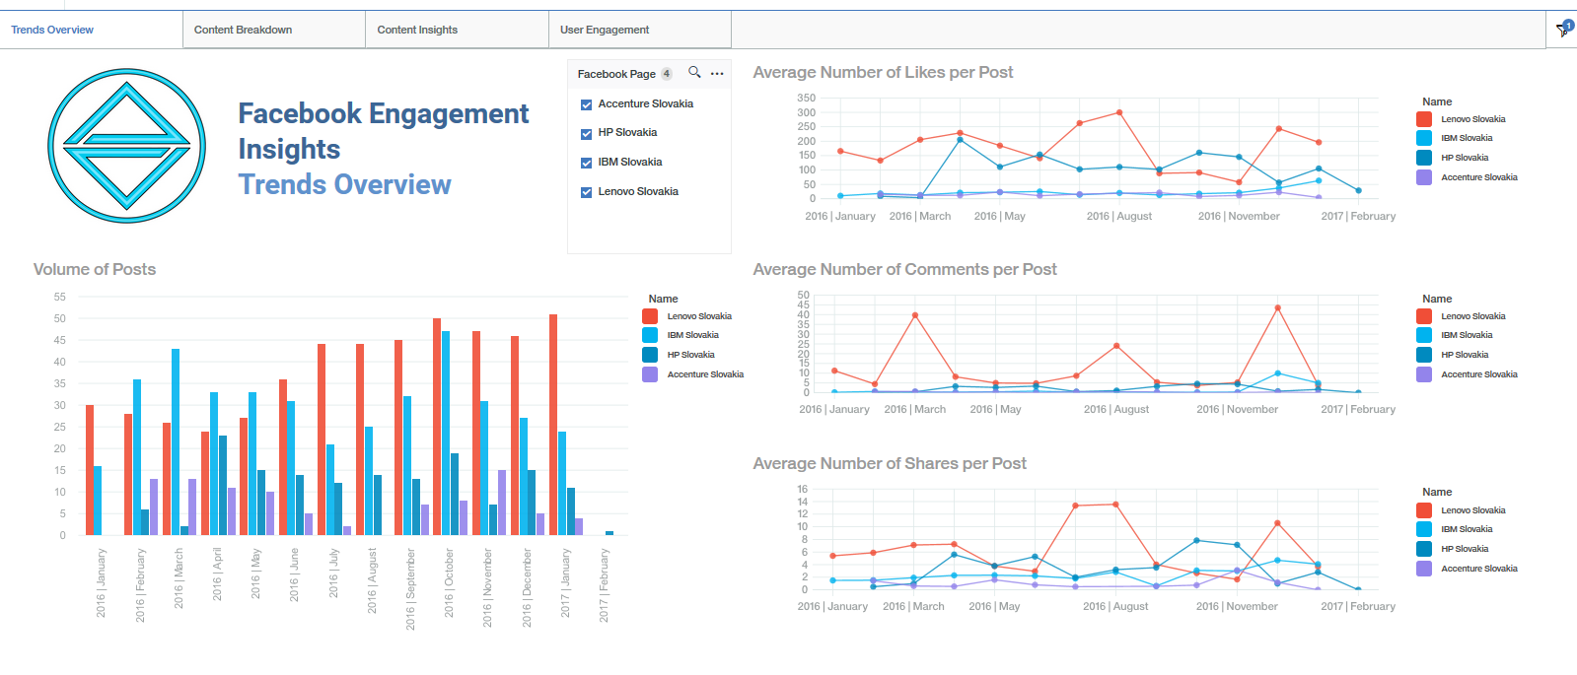
Solution Front-end: Trends Overview
Customizable comparison of several Facebook pages
Overview of historical trends on volume of posts
Overview of historical trends on average number of likes, comments and shares per post

Slide 48
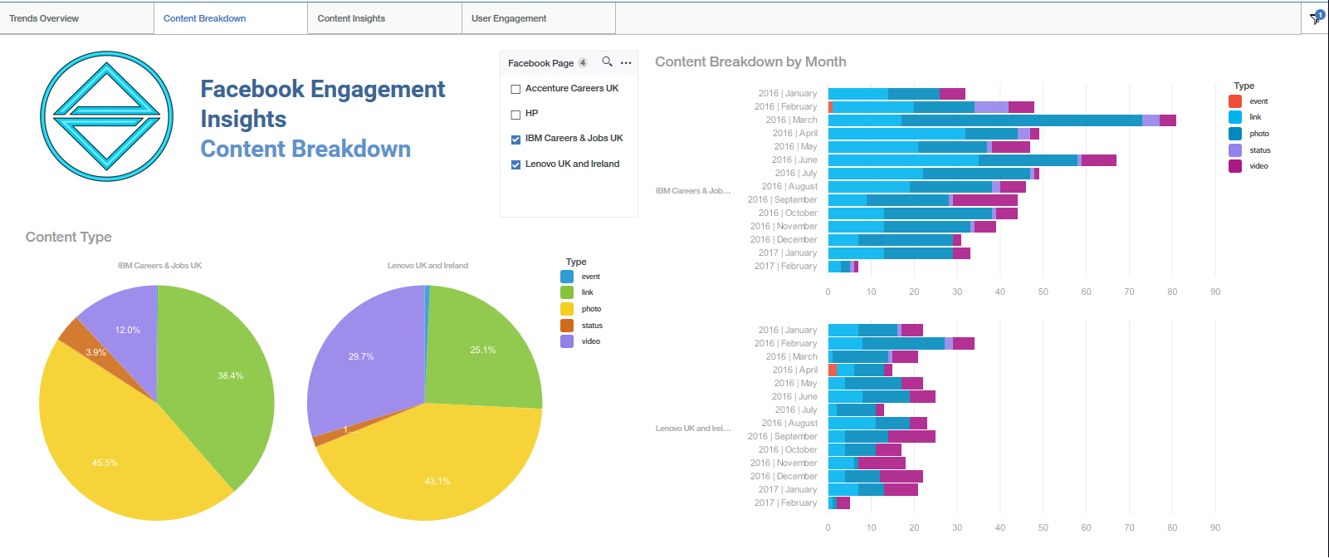
Solution Front-end: Content Breakdown
Customizable comparison of several Facebook pages
Activity breakdown by content type
Overview of historical trends by content type

Slide 49
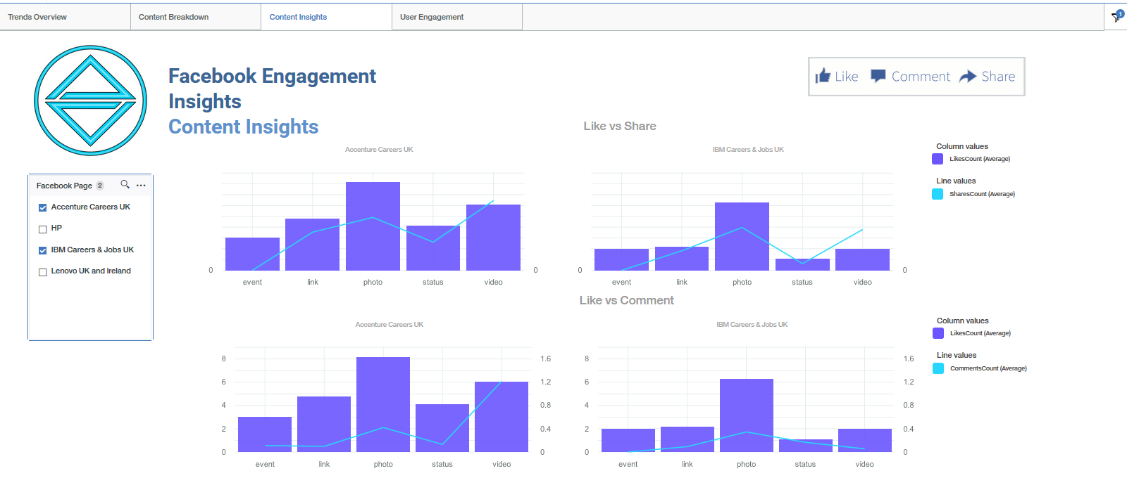
Solution Front-end: Content Insights
Overview of user engagement by content type
Customizable comparison of several Facebook pages

Slide 50
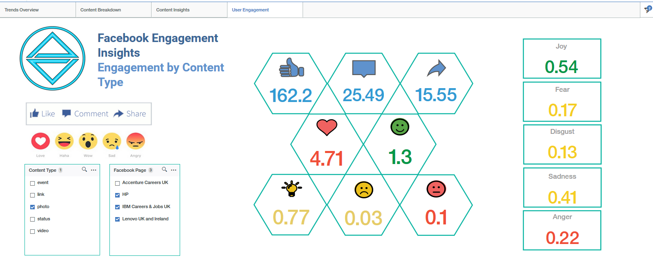
Solution Front-end: User Engagement
Overview of average values by post for 8 different forms of engagement
Customizable comparison of content types and Facebook pages
Insights on the most relevant emotions covered in the posts

Slide 51
Cognitive Engagement and Attrition Reporting (CEAR)
A True Cognitive application

Slide 52
On average, a STS newcomer is 80% less productive than an experienced employee during the 6-month adaptation period

Slide 53
On average, each attrition has a cost in productivity loss of 0,34 FTE for the STS organization
Interview conducted by Hiring managers & Team leader +follow-up
(60-min interviews + 15 mins follow-up) *
3 candidates *
2 atendees
0.01 FTE
Newcomers' productivity loss during adaptation period
(20 working days/month) *
(8 working hours /day) *
(80% productivity loss during adaptation period) *
(3 month average adaptation period)
0.23 FTE
Education of newcomer by focal point
(20 working days/month) *
(3 working hours /day) *
(3 month average adaptation period)
0.11 FTE

Slide 54



CEAR 5-step Approach
IDENTIFY – Managers identify employees
with high/critical attrition risk in CEAR dashboard
ANALYZE – Managers are provided with likely reasons for leaving based on the employee profile, as well as historical results on employee feedback including sentiment analysis.
ENGAGE – Managers engage with employees at risk in order to get a better understanding of motivation factors and current satisfaction level.
MITIGATE – Based on all information collected, Managers take action to mitigate the attrition risk of the employees
VALIDATE – Project team tracks tool adoption, measuring and validating its impact on attrition results on a quarterly basis

Slide 55
CEAR is a cognitive solution that leverages the analysis of structured and unstructured data to provide People Managers with early insights into potential attrition scenarios, by estimating the employee attrition risk and pointing at potential reasons for leaving based on the employee profile.
The solution allows People Managers to take early action and prevent top talents from leaving the company, moving from a reactive to a proactive approach when managing attrition.
Business Problem: Attrition
Data for solution
Interviewing costs
Capital HR metrics
Hard Cost
Newcomers’ adaptation period
Structured
Employee feedback (closed-ended questions)
Training costs
HR Volatility Index
Lower engagement
Open-ended comments from employee feedback
Soft Cost
Talent & knowledge loss
Unstructured
Brand impact

Slide 56


Solution architecture mixes cloud and on premise
Workday
contains the structured data
SPSS Modeler
is the predictive engine
DashDB
stores the data persistently
Watson Analytics
is the presentation front end
IBM Forms Experience builder generates feedback survey data
Node Red
retrieves the data
Alchemy API
performs the sentiment analysis

Slide 57
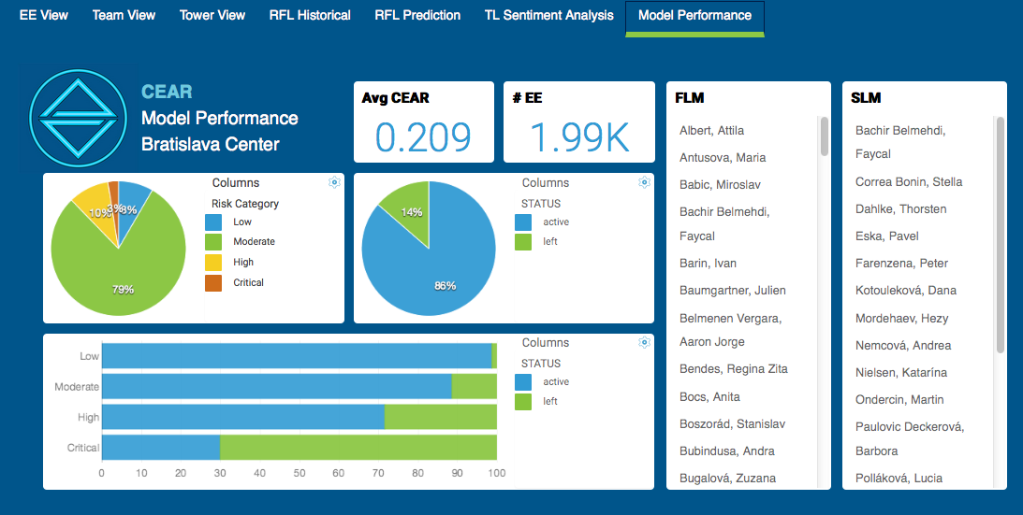
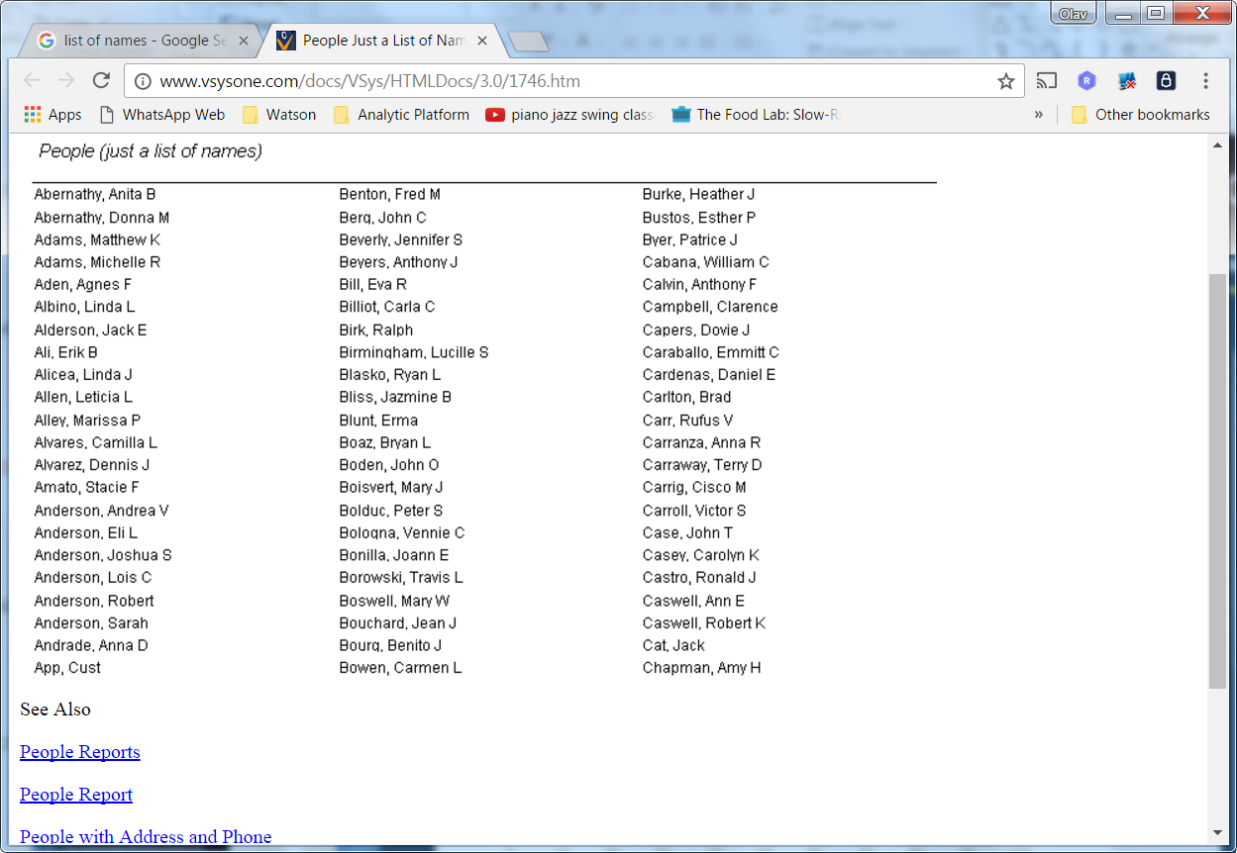
Executive dashboard

Slide 58
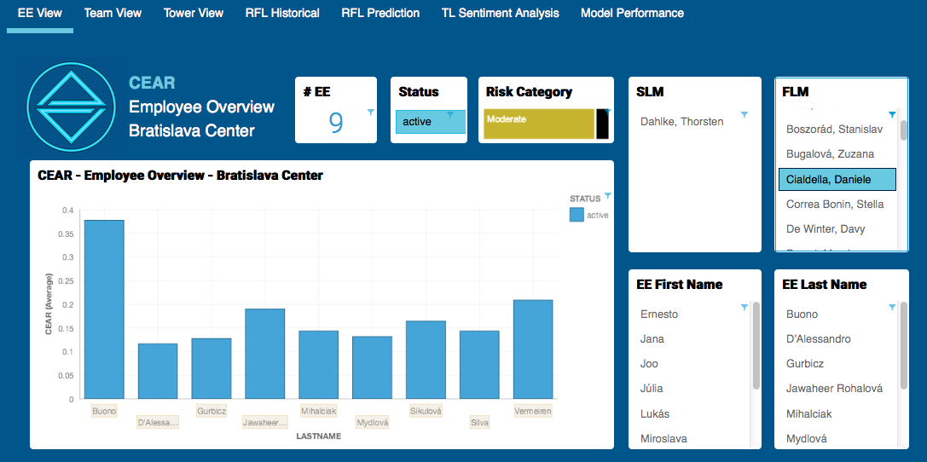
People Managers can identify employees with high/critical attrition risk
Risk is displayed through a coefficient of Employee Attrition Risk ranging from 0 to 1.
Results can be easily filtered by SLM, FLM, EE First Name and EE Last Name.

Slide 59
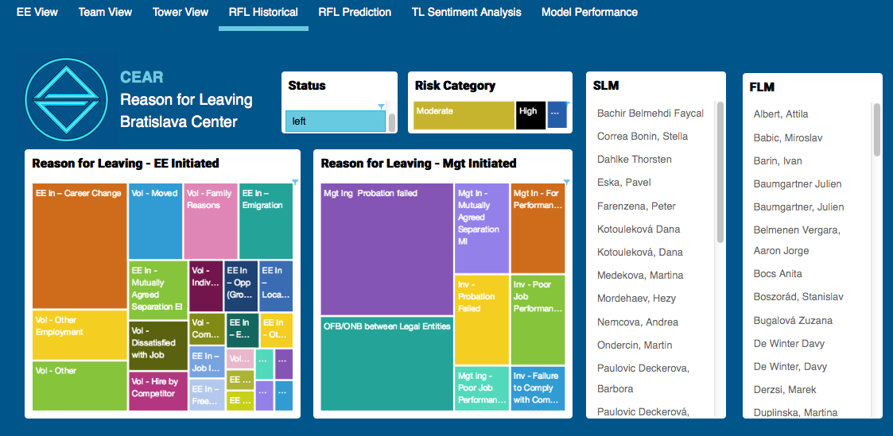
People Managers are provided with an overview of the Reason for Leaving indicated by the employees in the exit interviews
Results are broken down into Employee-initiated and Manager-initiated attrition scenarios.

Slide 60
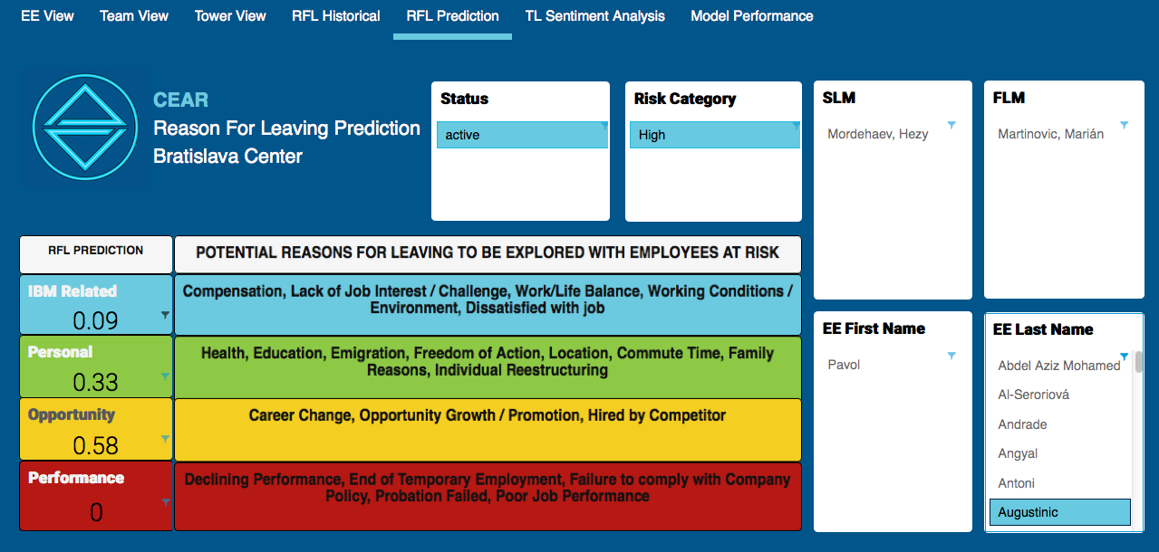
People Managers get insights on the most likely reason for leaving for employees at high / critical risk, based on historical results from employees with similar profiles

Slide 61
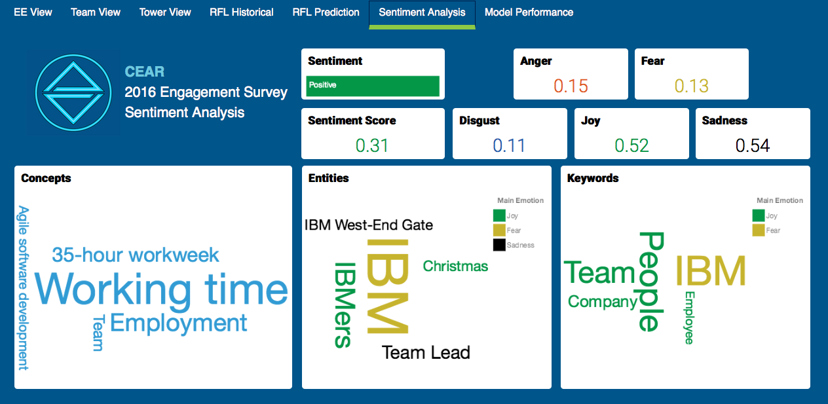
People Managers are provided with an overview of the Sentiment Analysis results from employee feedback surveys.

Slide 62
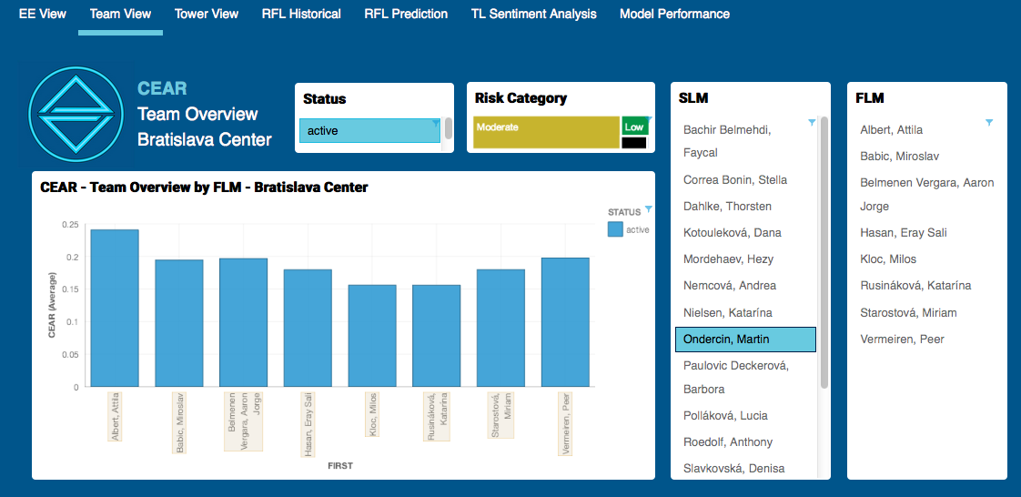
Second Line Managers can identify the First Line Managers whose teams have the highest average Coefficient of Employee Attrition Risk.

Slide 63
GOING ONE STEP DEEPER

Slide 64
COMPONENTS

Slide 65
Bluemix
IBM Bluemix is a cloud platform as a service (PaaS) developed by IBM. It supports several programming languages and services as well as integrated DevOps to build, run, deploy and manage applications on the cloud. Bluemix is based on Cloud Foundry open technology and runs on SoftLayer infrastructure.
https://console.ng.bluemix.net/
Dr. Olav Laudy
Putting data to work
Dr. Olav Laudy
Putting data to work
Dr. Olav Laudy
Putting data to work
Dr. Olav Laudy
Putting data to work
Dr. Olav Laudy
Putting data to work
Dr. Olav Laudy
Putting data to work
Dr. Olav Laudy
Putting data to work

Slide 66
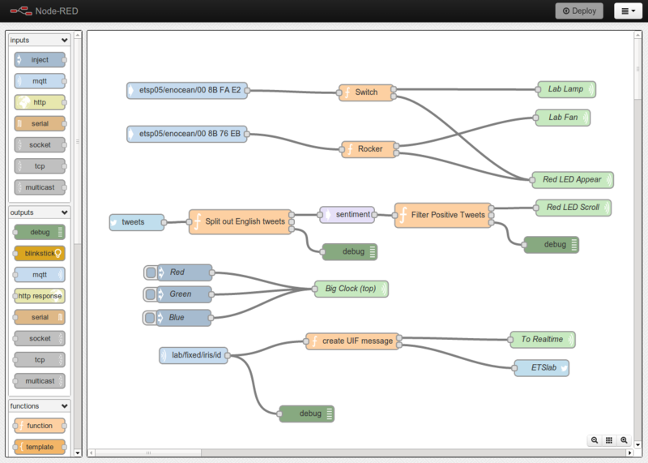
Node-RED
Dr. Olav Laudy
Putting data to work
A visual tool for wiring the Internet of Things. Node-RED is a tool for wiring together hardware devices, APIs and online services in new and interesting ways. Flows can be then deployed to the Node.js runtime with a single click.
http://noderedguide.com/
Dr. Olav Laudy
Putting data to work
Dr. Olav Laudy
Putting data to work
Dr. Olav Laudy
Putting data to work
Dr. Olav Laudy
Putting data to work
Dr. Olav Laudy
Putting data to work
Dr. Olav Laudy
Putting data to work

Slide 67
Storage
Dr. Olav Laudy
Putting data to work
DashDB
IBM dashDB is a cloud data warehouse service for analytics, reporting and business intelligence (BI). IBM manages the setup, configuration and operation of IBM dashDB. Designed for performance and scale, it uses IBM BLU Acceleration, embedded Netezza analytics and MPP architecture.
It’s compatible with advanced analytics tooling, including R predictive analytics and IBM Watson Analytics. It works with a wide range of third-party BI tools. IBM dashDB is available as a service on the IBM Bluemix cloud platform and connects directly with other IBM cloud data services.
Cloudant
Cloudant is an open source non-relational, distributed database service of the same name that requires zero-configuration. Cloudant is based on the Apache-backed CouchDB project and the open source BigCouch project.
Dr. Olav Laudy
Putting data to work
Dr. Olav Laudy
Putting data to work
Dr. Olav Laudy
Putting data to work
Dr. Olav Laudy
Putting data to work
Dr. Olav Laudy
Putting data to work
Dr. Olav Laudy
Putting data to work

Slide 68


Cognitive components
Watson Visual recognition
Visual Recognition allows users to understand the contents of an image or video frame, answering the question: “What is in this image?” Submit an image, and the service returns scores for relevant classifiers representing things such as objects, events and settings.
Watson Retrieve and Rank
This service helps users find the most relevant information for their query by using a combination of search and machine learning algorithms to detect "signals" in the data. Built on top of Apache Solr, developers load their data into the service, train a machine learning model based on known relevant results, then leverage this model to provide improved results to their end users based on their question or query.
Watson Conversation
The IBM Watson Conversation service enables a developer to automate branching conversations between a user and your application. The Conversation service enables your applications to use natural language to automatically respond to user questions, cross-sell and up-sell, walk users through processes or applications, or even hand-hold users through difficult tasks.
The Conversation service can track and store user profile information to learn more about end users, guide them through processes based on their unique situation, or pass their information to a back-end system to help them take action and get the help they need.
Dr. Olav Laudy
Putting data to work
Dr. Olav Laudy
Putting data to work
Dr. Olav Laudy
Putting data to work
Dr. Olav Laudy
Putting data to work
Dr. Olav Laudy
Putting data to work
Dr. Olav Laudy
Putting data to work
Dr. Olav Laudy
Putting data to work

Slide 69
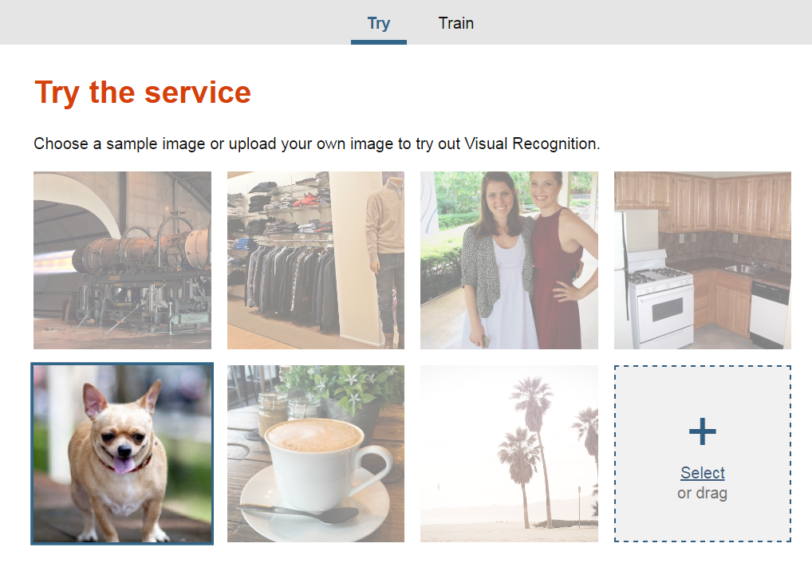
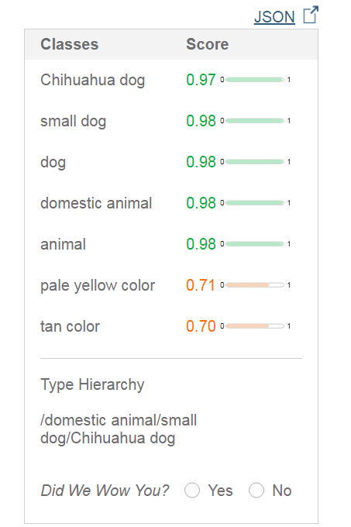
Dr. Olav Laudy
Putting data to work
Dr. Olav Laudy
Putting data to work
Dr. Olav Laudy
Putting data to work
Dr. Olav Laudy
Putting data to work
Dr. Olav Laudy
Putting data to work
Dr. Olav Laudy
Putting data to work
Dr. Olav Laudy
Putting data to work
https://visual-recognition-demo.mybluemix.net/

Slide 70
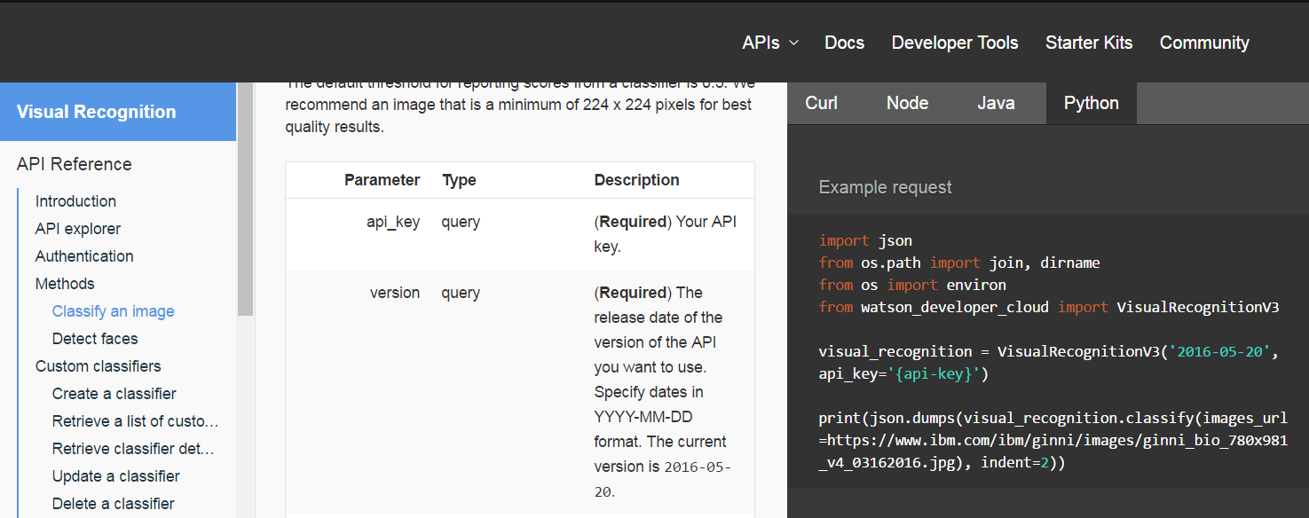
Extensive documentation
Dr. Olav Laudy
Putting data to work
Dr. Olav Laudy
Putting data to work
Dr. Olav Laudy
Putting data to work
Dr. Olav Laudy
Putting data to work
Dr. Olav Laudy
Putting data to work
Dr. Olav Laudy
Putting data to work
Dr. Olav Laudy
Putting data to work

Slide 71
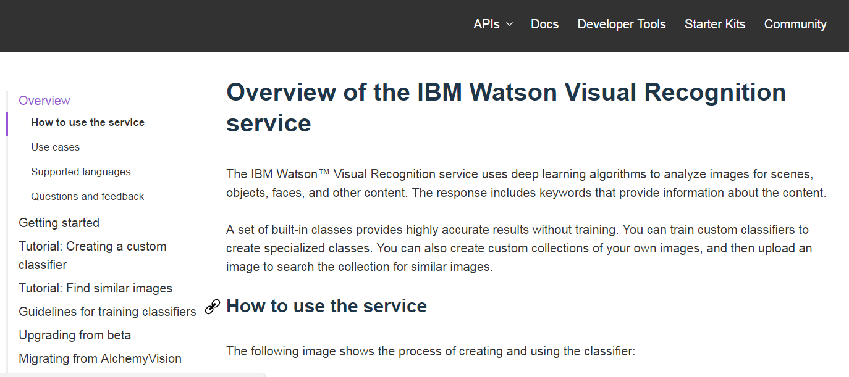
Extensive documentation
Dr. Olav Laudy
Putting data to work
Dr. Olav Laudy
Putting data to work
Dr. Olav Laudy
Putting data to work
Dr. Olav Laudy
Putting data to work
Dr. Olav Laudy
Putting data to work
Dr. Olav Laudy
Putting data to work
Dr. Olav Laudy
Putting data to work

Slide 72

Extensive documentation
Dr. Olav Laudy
Putting data to work
Dr. Olav Laudy
Putting data to work
Dr. Olav Laudy
Putting data to work
Dr. Olav Laudy
Putting data to work
Dr. Olav Laudy
Putting data to work
Dr. Olav Laudy
Putting data to work
Dr. Olav Laudy
Putting data to work

Slide 73

Extensive documentation
Dr. Olav Laudy
Putting data to work
Dr. Olav Laudy
Putting data to work
Dr. Olav Laudy
Putting data to work
Dr. Olav Laudy
Putting data to work
Dr. Olav Laudy
Putting data to work
Dr. Olav Laudy
Putting data to work
Dr. Olav Laudy
Putting data to work

Slide 74

Dr. Olav Laudy
Putting data to work
Dr. Olav Laudy
Putting data to work
Dr. Olav Laudy
Putting data to work
Dr. Olav Laudy
Putting data to work
Dr. Olav Laudy
Putting data to work
Dr. Olav Laudy
Putting data to work
Dr. Olav Laudy
Putting data to work
http://retrieve-and-rank-demo.mybluemix.net/

Slide 75

Dr. Olav Laudy
Putting data to work
Dr. Olav Laudy
Putting data to work
Dr. Olav Laudy
Putting data to work
Dr. Olav Laudy
Putting data to work
Dr. Olav Laudy
Putting data to work
Dr. Olav Laudy
Putting data to work
Dr. Olav Laudy
Putting data to work
https://conversation-demo.mybluemix.net/

Slide 76

Watson Machine learning
Predictive Analytics for Bluemix is an offering that makes it easy for developers and data scientists to work together to integrate predictive analytics with their applications. Using the SPSS analytics platform, Predictive Analytics allows you to score (predictive) models built in the IBM SPSS Modeler client . The Predictive Analytics service is a set of REST APIs that can be called from any programming language.
Dr. Olav Laudy
Putting data to work
Dr. Olav Laudy
Putting data to work
Dr. Olav Laudy
Putting data to work
Dr. Olav Laudy
Putting data to work
Dr. Olav Laudy
Putting data to work
Dr. Olav Laudy
Putting data to work
Dr. Olav Laudy
Putting data to work
https://product-line-prediction-alexj42-855.mybluemix.net/

Slide 77


Non IBM component used in this demo
Dr. Olav Laudy
Putting data to work
Dr. Olav Laudy
Putting data to work
Slack is an instant messaging and collaboration system.
Channels : separate messages, discussions and notifications by purpose, department or topic.
Private Channels
Direct Messages
File sharing
Search
Notifications
Build your own integrations.
Slack is being used as integration channel
Dr. Olav Laudy
Putting data to work
Dr. Olav Laudy
Putting data to work
Dr. Olav Laudy
Putting data to work
Dr. Olav Laudy
Putting data to work
Dr. Olav Laudy
Putting data to work

Slide 78
Tell me a joke about IBM

Slide 79

Bluemix
Dr. Olav Laudy
Putting data to work
https://new-console.ng.bluemix.net
Dr. Olav Laudy
Putting data to work
Dr. Olav Laudy
Putting data to work
Dr. Olav Laudy
Putting data to work
Dr. Olav Laudy
Putting data to work
Dr. Olav Laudy
Putting data to work
Dr. Olav Laudy
Putting data to work

Slide 80

Dr. Olav Laudy
Putting data to work
Dr. Olav Laudy
Putting data to work
Dr. Olav Laudy
Putting data to work
Dr. Olav Laudy
Putting data to work
Dr. Olav Laudy
Putting data to work
Node-RED Boilerplate
Dr. Olav Laudy
Putting data to work
Dr. Olav Laudy
Putting data to work

Slide 81



Dr. Olav Laudy
Putting data to work
Dr. Olav Laudy
Putting data to work
Dr. Olav Laudy
Putting data to work
Dr. Olav Laudy
Putting data to work
Dr. Olav Laudy
Putting data to work
Dr. Olav Laudy
Putting data to work
Dr. Olav Laudy
Putting data to work

Slide 82

Send an email to jokes@laudy.net with
in the subject line
a natural language question asking
you want to receive a joke
on a particular topic
Dr. Olav Laudy
Putting data to work
Dr. Olav Laudy
Putting data to work
Dr. Olav Laudy
Putting data to work
Dr. Olav Laudy
Putting data to work
Dr. Olav Laudy
Putting data to work
Dr. Olav Laudy
Putting data to work
Dr. Olav Laudy
Putting data to work

Slide 83






Email in-&output definitions
Dr. Olav Laudy
Putting data to work
Dr. Olav Laudy
Putting data to work
Dr. Olav Laudy
Putting data to work
Dr. Olav Laudy
Putting data to work
Dr. Olav Laudy
Putting data to work
Dr. Olav Laudy
Putting data to work
Dr. Olav Laudy
Putting data to work

Slide 84

The Watson Retrieve and Rank visual interface
Dr. Olav Laudy
Putting data to work
Dr. Olav Laudy
Putting data to work
Dr. Olav Laudy
Putting data to work
Dr. Olav Laudy
Putting data to work
Dr. Olav Laudy
Putting data to work
Dr. Olav Laudy
Putting data to work
Dr. Olav Laudy
Putting data to work
https://watson-retrieve-and-rank.ng.bluemix.net/login

Slide 85



Upload of base data
Dr. Olav Laudy
Putting data to work
Dr. Olav Laudy
Putting data to work
Dr. Olav Laudy
Putting data to work
Dr. Olav Laudy
Putting data to work
Dr. Olav Laudy
Putting data to work
Headers to ensure question separation
Dr. Olav Laudy
Putting data to work
Headers to ensure question separation
Dr. Olav Laudy
Putting data to work
http://www.ibm.com/watson/developercloud/doc/document-conversion/customizing.shtml

Slide 86


Upload of the questions
Dr. Olav Laudy
Putting data to work
Dr. Olav Laudy
Putting data to work
Dr. Olav Laudy
Putting data to work
Dr. Olav Laudy
Putting data to work
Dr. Olav Laudy
Putting data to work
Dr. Olav Laudy
Putting data to work
Dr. Olav Laudy
Putting data to work

Slide 87


Defining the right answers to the questions
Dr. Olav Laudy
Putting data to work
Dr. Olav Laudy
Putting data to work
Dr. Olav Laudy
Putting data to work
Dr. Olav Laudy
Putting data to work
Dr. Olav Laudy
Putting data to work
Dr. Olav Laudy
Putting data to work
Dr. Olav Laudy
Putting data to work

Slide 88


Trying out the ranker
Dr. Olav Laudy
Putting data to work
Dr. Olav Laudy
Putting data to work
Dr. Olav Laudy
Putting data to work
Dr. Olav Laudy
Putting data to work
Dr. Olav Laudy
Putting data to work
Dr. Olav Laudy
Putting data to work
Dr. Olav Laudy
Putting data to work

Slide 89

Understanding how to call the rest API
Dr. Olav Laudy
Putting data to work
Dr. Olav Laudy
Putting data to work
Dr. Olav Laudy
Putting data to work
Dr. Olav Laudy
Putting data to work
Dr. Olav Laudy
Putting data to work
Dr. Olav Laudy
Putting data to work
Dr. Olav Laudy
Putting data to work
https://watson-api-explorer.mybluemix.net/apis/retrieve-and-rank-v1#!/solr_clusters/select

Slide 90




Calling the Retrieve and rank REST API and creating the output
Dr. Olav Laudy
Putting data to work
Dr. Olav Laudy
Putting data to work
1
1
2
Dr. Olav Laudy
Putting data to work
Dr. Olav Laudy
Putting data to work
3
Dr. Olav Laudy
Putting data to work
3
Dr. Olav Laudy
Putting data to work
2
Dr. Olav Laudy
Putting data to work

Slide 91


Receiving a joke in your email
Dr. Olav Laudy
Putting data to work
Dr. Olav Laudy
Putting data to work
Dr. Olav Laudy
Putting data to work
Dr. Olav Laudy
Putting data to work
Dr. Olav Laudy
Putting data to work
Dr. Olav Laudy
Putting data to work
Dr. Olav Laudy
Putting data to work

Slide 92
Are you a dog or a cat person?

Slide 93


Dr. Olav Laudy
Putting data to work
Dr. Olav Laudy
Putting data to work
Dr. Olav Laudy
Putting data to work
Dr. Olav Laudy
Putting data to work
Dr. Olav Laudy
Putting data to work
Dr. Olav Laudy
Putting data to work
Dr. Olav Laudy
Putting data to work

Slide 94

Dr. Olav Laudy
Putting data to work
Dr. Olav Laudy
Putting data to work
Dr. Olav Laudy
Putting data to work
Dr. Olav Laudy
Putting data to work
Dr. Olav Laudy
Putting data to work
Dr. Olav Laudy
Putting data to work
Dr. Olav Laudy
Putting data to work

Slide 95



Dr. Olav Laudy
Putting data to work
Dr. Olav Laudy
Putting data to work
Dr. Olav Laudy
Putting data to work
Dr. Olav Laudy
Putting data to work
Dr. Olav Laudy
Putting data to work
Dr. Olav Laudy
Putting data to work
Dr. Olav Laudy
Putting data to work
Retrieve Tweets
Store Tweets in Cloudant

Slide 96



Web interface of Cloudant
Dr. Olav Laudy
Putting data to work
Dr. Olav Laudy
Putting data to work
Dr. Olav Laudy
Putting data to work
Dr. Olav Laudy
Putting data to work
Dr. Olav Laudy
Putting data to work
Dr. Olav Laudy
Putting data to work
Dr. Olav Laudy
Putting data to work

Slide 97



Extract an image from the Tweet
Dr. Olav Laudy
Putting data to work
Dr. Olav Laudy
Putting data to work
Dr. Olav Laudy
Putting data to work
Dr. Olav Laudy
Putting data to work
Dr. Olav Laudy
Putting data to work
Dr. Olav Laudy
Putting data to work
Dr. Olav Laudy
Putting data to work

Slide 98

Use Alchemy Visual API to figure out what’s on the image
Dr. Olav Laudy
Putting data to work
Dr. Olav Laudy
Putting data to work
Dr. Olav Laudy
Putting data to work
Dr. Olav Laudy
Putting data to work
Dr. Olav Laudy
Putting data to work
Dr. Olav Laudy
Putting data to work
Dr. Olav Laudy
Putting data to work

Slide 99




Store the classification in DashDB
Debug output
Dr. Olav Laudy
Putting data to work
Dr. Olav Laudy
Putting data to work
Dr. Olav Laudy
Putting data to work
Dr. Olav Laudy
Putting data to work
Dr. Olav Laudy
Putting data to work
Dr. Olav Laudy
Putting data to work
Dr. Olav Laudy
Putting data to work

Slide 100

Web interface of DashDB
Dr. Olav Laudy
Putting data to work
Dr. Olav Laudy
Putting data to work
Dr. Olav Laudy
Putting data to work
Dr. Olav Laudy
Putting data to work
Dr. Olav Laudy
Putting data to work
Dr. Olav Laudy
Putting data to work
Dr. Olav Laudy
Putting data to work

Slide 101



Details to create a local ODBC connection
Locally:
Dr. Olav Laudy
Putting data to work
Dr. Olav Laudy
Putting data to work
Dr. Olav Laudy
Putting data to work
Dr. Olav Laudy
Putting data to work
Dr. Olav Laudy
Putting data to work
Dr. Olav Laudy
Putting data to work
Dr. Olav Laudy
Putting data to work
**********

Slide 102





Build a dog vs. cat classifier in SPSS Modeler
Dr. Olav Laudy
Putting data to work
Dr. Olav Laudy
Putting data to work
Design/create the database table
Dr. Olav Laudy
Putting data to work
Dr. Olav Laudy
Putting data to work
Dr. Olav Laudy
Putting data to work
Build the model and scoring stream
Dr. Olav Laudy
Putting data to work
Dr. Olav Laudy
Putting data to work
Deploy (right click the end-node)

Slide 103

The scoring stream in Node-RED
Dr. Olav Laudy
Putting data to work
Dr. Olav Laudy
Putting data to work
Get a tweet
Check if user has already received a tweet from me
Create tweet based on model score
Create scoring call
Score in SPSS scoring service
Tweet and store user in database to prevent repetition
Dr. Olav Laudy
Putting data to work
Dr. Olav Laudy
Putting data to work
Dr. Olav Laudy
Putting data to work
Dr. Olav Laudy
Putting data to work
Dr. Olav Laudy
Putting data to work
testing

Slide 104





Part 1: check if the user has already been Tweeted to
Dr. Olav Laudy
Putting data to work
Dr. Olav Laudy
Putting data to work
1
Dr. Olav Laudy
Putting data to work
Dr. Olav Laudy
Putting data to work
2
Dr. Olav Laudy
Putting data to work
Dr. Olav Laudy
Putting data to work
Dr. Olav Laudy
Putting data to work
3

Slide 105









Part 2: score in Bluemix Predictive Analytics
Dr. Olav Laudy
Putting data to work
Dr. Olav Laudy
Putting data to work
Dr. Olav Laudy
Putting data to work
Dr. Olav Laudy
Putting data to work
Dr. Olav Laudy
Putting data to work
Dr. Olav Laudy
Putting data to work
Dr. Olav Laudy
Putting data to work

Slide 106







Part 3: Tweet the classification result
Dr. Olav Laudy
Putting data to work
Dr. Olav Laudy
Putting data to work
Dr. Olav Laudy
Putting data to work
Dr. Olav Laudy
Putting data to work
Dr. Olav Laudy
Putting data to work
Dr. Olav Laudy
Putting data to work
Dr. Olav Laudy
Putting data to work

Slide 107



Result in Twitter
Dr. Olav Laudy
Putting data to work
Dr. Olav Laudy
Putting data to work
Dr. Olav Laudy
Putting data to work
Dr. Olav Laudy
Putting data to work
Dr. Olav Laudy
Putting data to work
Dr. Olav Laudy
Putting data to work
Dr. Olav Laudy
Putting data to work

Slide 108
A slack bot

Slide 109

Dr. Olav Laudy
Putting data to work
Dr. Olav Laudy
Putting data to work
Dr. Olav Laudy
Putting data to work
Dr. Olav Laudy
Putting data to work
Dr. Olav Laudy
Putting data to work
Dr. Olav Laudy
Putting data to work
Dr. Olav Laudy
Putting data to work

Slide 110

Read slack input
Dr. Olav Laudy
Putting data to work
Dr. Olav Laudy
Putting data to work
Bot capabilities
Post to slack
Dr. Olav Laudy
Putting data to work
Dr. Olav Laudy
Putting data to work
Figure out what to do
Dr. Olav Laudy
Putting data to work
Dr. Olav Laudy
Putting data to work
Dr. Olav Laudy
Putting data to work

Slide 111












Defining the integration with Slack
Dr. Olav Laudy
Putting data to work
Dr. Olav Laudy
Putting data to work
Dr. Olav Laudy
Putting data to work
Dr. Olav Laudy
Putting data to work
Dr. Olav Laudy
Putting data to work
Dr. Olav Laudy
Putting data to work
Dr. Olav Laudy
Putting data to work

Slide 112

Capabilities of the bot
Dr. Olav Laudy
Putting data to work
Dr. Olav Laudy
Putting data to work
Give me a Chuck Norris quote
Dr. Olav Laudy
Putting data to work
Dr. Olav Laudy
Putting data to work
Give me a random coin flip
Invoke Watson dialog service
Dr. Olav Laudy
Putting data to work
Tell me a joke
Dr. Olav Laudy
Putting data to work
Show me the options
Dr. Olav Laudy
Putting data to work

Slide 113




Give me a Chuck Norris quote
Dr. Olav Laudy
Putting data to work
Dr. Olav Laudy
Putting data to work
Dr. Olav Laudy
Putting data to work
Dr. Olav Laudy
Putting data to work
Dr. Olav Laudy
Putting data to work
Dr. Olav Laudy
Putting data to work
Dr. Olav Laudy
Putting data to work

Slide 114



Provide me a random coin flip
Dr. Olav Laudy
Putting data to work
Dr. Olav Laudy
Putting data to work
Dr. Olav Laudy
Putting data to work
Dr. Olav Laudy
Putting data to work
Dr. Olav Laudy
Putting data to work
Dr. Olav Laudy
Putting data to work
Dr. Olav Laudy
Putting data to work

Slide 115




Watson Conversation service (old: dialog service): defining the intents
Dr. Olav Laudy
Putting data to work
Dr. Olav Laudy
Putting data to work
Dr. Olav Laudy
Putting data to work
Dr. Olav Laudy
Putting data to work
Dr. Olav Laudy
Putting data to work
Dr. Olav Laudy
Putting data to work
Dr. Olav Laudy
Putting data to work

Slide 116

Watson Conversation service: defining the entities
Dr. Olav Laudy
Putting data to work
Dr. Olav Laudy
Putting data to work
Dr. Olav Laudy
Putting data to work
Dr. Olav Laudy
Putting data to work
Dr. Olav Laudy
Putting data to work
Dr. Olav Laudy
Putting data to work
Dr. Olav Laudy
Putting data to work

Slide 117


Watson Conversation service: defining the dialog
Dr. Olav Laudy
Putting data to work
Dr. Olav Laudy
Putting data to work
Dr. Olav Laudy
Putting data to work
Dr. Olav Laudy
Putting data to work
Dr. Olav Laudy
Putting data to work
Dr. Olav Laudy
Putting data to work
Dr. Olav Laudy
Putting data to work

Slide 118








Calling Watson Conversation service, taking into account the context
Dr. Olav Laudy
Putting data to work
Dr. Olav Laudy
Putting data to work
Dr. Olav Laudy
Putting data to work
Dr. Olav Laudy
Putting data to work
Dr. Olav Laudy
Putting data to work
Dr. Olav Laudy
Putting data to work
Dr. Olav Laudy
Putting data to work

Slide 119










Cloudant: defining an index in order to query. (in this case: we want to sort on time)
Dr. Olav Laudy
Putting data to work
Dr. Olav Laudy
Putting data to work
Dr. Olav Laudy
Putting data to work
Dr. Olav Laudy
Putting data to work
Dr. Olav Laudy
Putting data to work
Dr. Olav Laudy
Putting data to work
Dr. Olav Laudy
Putting data to work

Slide 120


Result of the Conversation service in Slack
Dr. Olav Laudy
Putting data to work
Dr. Olav Laudy
Putting data to work
Dr. Olav Laudy
Putting data to work
Dr. Olav Laudy
Putting data to work
Dr. Olav Laudy
Putting data to work
Dr. Olav Laudy
Putting data to work
Dr. Olav Laudy
Putting data to work

Slide 121



The joke and help functionality
Dr. Olav Laudy
Putting data to work
Dr. Olav Laudy
Putting data to work
Dr. Olav Laudy
Putting data to work
Dr. Olav Laudy
Putting data to work
Dr. Olav Laudy
Putting data to work
Dr. Olav Laudy
Putting data to work
Dr. Olav Laudy
Putting data to work

Slide 122
A Line bot

Slide 123


Components

Slide 124

Objective
Create a Line messaging bot who retrieves news on a certain topic and analyzes the tone on the news message.

Slide 125



Line messenger
Become friends with my bot
Allowing the bot to respond
A bot called Watson
The details to send and receive messages

Slide 126


In-and output

Slide 127




Getting the news item

Slide 128

The tone analyzer
To do:
Show json output

Slide 129


Creating the response message for Line

Slide 130

The result

Slide 131
Data science tooling @IBM
IBM data science experience

Slide 132


Slide 133

What is DSX?
IBM Data Science Experience is an environment that has everything a data scientist needs to be successful.
The Experience is an interactive, collaborative, cloud-based environment where data scientists can use multiple tools to activate their insights.
Data scientists can use the best of open source, tap into IBM's unique features, grow their capabilities, and share their successes.

Slide 134

Cloud based = a website that works the moment you log in. Cloud based = no install Cloud based = scale up – pay more ; scale down – pay less

Slide 135




Slide 136


Learn

Slide 137

Create: Jupyter notebook
Markup language: mix code and documentation

Slide 138


Full integration with Spark
Dr. Olav Laudy
Putting data to work
Dr. Olav Laudy
Putting data to work
Dr. Olav Laudy
Putting data to work
Dr. Olav Laudy
Putting data to work
Dr. Olav Laudy
Putting data to work
Dr. Olav Laudy
Putting data to work
Dr. Olav Laudy
Putting data to work

Slide 139

Create: R Studio

Slide 140
Create: Canvas

Slide 141
Clarification
Python
Python is a widely used high-level programming language for general-purpose programming, It emphasizes code readability and a syntax which allows programmers to express concepts in fewer lines of code than possible in other languages. The language provides constructs intended to enable writing clear programs on both a small and large scale.
Scala
Scala (Scalable Language) is a general-purpose programming language (designed around criticisms of Java).
R
R is an programming language and software environment for statistical computing and graphics that is supported by the R Foundation for Statistical Computing. The R language is widely used among statisticians and data miners for developing statistical software and data analysis.
Jupyter Notebook
The Jupyter Notebook is an open-source web application that allows you to create and share documents that contain live code, equations, visualizations and explanatory text.
R Studio
RStudio is a free and open-source integrated development environment (IDE) for R

Slide 142
Spark
Apache Spark is an open-source cluster-computing framework. Spark provides an interface for programming entire clusters centered on a data structure called the resilient distributed dataset (RDD), a read-only multiset of data items distributed over a cluster of machines.
It was developed in response to limitations in the MapReduce cluster computing paradigm. Spark facilitates the implementation of both
iterative algorithms, that visit their dataset multiple times in a loop, and
interactive/exploratory data analysis, i.e., the repeated database-style querying of data.
IBM: Spark is an analytics operating system for the modern enterprise

Slide 143

Spark – Scala - Python – R
Spark is written in Scala,
The open source community has developed wonderful toolkits that allows you to interface with RDD's in Python and R.
Without Spark
With Spark
Scala:
val data =io.Source.fromFile(“myfile.txt").mkString
Python:
data = open(“myfile.txt”,”w”)
R:
data = read.table("myfile.txt")
Scala:
val data = sc.textFile(" myfile.txt ")
Python:
data = sc.textFile(" myfile.txt ")
R:
sc <- sparkR.init()
data <- textFile(sc, "myfile.txt")

Slide 144


Collaborate
Multiple sharing options
Real time comments across shared documents
Work together on the same documents

Slide 145

Collaborate
Share on Github
-version control
-forking

Slide 146

Collaborate: Github forking

Slide 147


Execution control

Slide 148

Scaling app & storage

Slide 149

Scaling

Slide 150
New offerings: DSX local – DSX desktop
DSX Desktop
A pre-built Jupyter Notebook & R-studio environment that runs locally inside a Docker container.
Docker is an open-source project that automates the deployment of applications inside software containers <virtual environment>.
The convenience of a full fledged install without the hassle of installing all the components individually. Install & go.
DSX Local
A ‘copy’ of what is available in the cloud, but then installed on premise.
All components, including the collaboration tools in one deployment.

Slide 151
Product view
Dr. Olav Laudy
Putting data to work
Data Engineering
Dr. Olav Laudy
Putting data to work
Business Analysis
Dr. Olav Laudy
Putting data to work
Dr. Olav Laudy
Putting data to work
Dr. Olav Laudy
Putting data to work
Data Science
App Development

Slide 152
IBM Data Hub

Slide 153

Data Hub is one step away from DSX

Slide 154
Manage data with Data Hub
Data Hub makes it easy to connect data with people:
Curate data assets with multiple structured and unstructured formats from heterogenous types of data sources.
Assign fine-grain permissions for each user.

Slide 155
What you can do with Data Hub
Get data ready for analysis:
Load data files to the cloud
Securely move data between cloud services or on-premises data sources
Create secured connections to data in the cloud or on premises
Ingest streaming data
Categorize data in a catalog with metadata for searching
Assign usage permissions to data in a catalog

Slide 156
What you can do with Data Hub
Get users ready to analyze data:
Add collaborators to a catalog, with the appropriate permissions. A collaborator authenticates once for all data and tools.
Add collaborators to projects, with appropriate permissions
Govern data and user activity in a catalog:
Monitor automatically classified data types
Monitor data lineage and usage
Manage your services that store or stream data:

Slide 157


Connected to wide range of data storage options
Build in data: weather & Twitter
SQL, noSQL

Slide 158


IBM Data Hub opens up the use of streaming data
Dr. Olav Laudy
Putting data to work
Dr. Olav Laudy
Putting data to work
Dr. Olav Laudy
Putting data to work
Dr. Olav Laudy
Putting data to work
Dr. Olav Laudy
Putting data to work
Dr. Olav Laudy
Putting data to work
Dr. Olav Laudy
Putting data to work

Slide 159
Catalogs (aka data lake)
A catalog is a cloud-based data repository for structured and unstructured data from a variety of sources. You copy and categorize data assets into the catalog and add collaborators who can analyze the data. You create projects to organize data, analytical tools, and collaborators.
Catalog collaborators can access data assets in the catalog that they are members of without knowing the access keys or tokens. After collaborators log in to the catalog, they are fully authenticated for accessing catalog assets for which they have permissions.
A catalog has two types of storage areas for data assets:
Shared zone: Contains governed, read-only data assets. All catalog members can see all data assets.
Project sandboxes: Contains updatable data assets that belong to a project. Each project has a separate sandbox. Only project members can see and edit project assets.

Slide 160


Catalog screenshots
Permission overview
Usage overview

Slide 161
Education material

Slide 162

IBM training on all tools
Dr. Olav Laudy
Putting data to work
Dr. Olav Laudy
Putting data to work
Dr. Olav Laudy
Putting data to work
Dr. Olav Laudy
Putting data to work
Dr. Olav Laudy
Putting data to work
Dr. Olav Laudy
Putting data to work
Dr. Olav Laudy
Putting data to work
https://bigdatauniversity.com/courses/data-science-hands-open-source-tools/

Slide 163

Interact with the community and share your achievements
Dr. Olav Laudy
Putting data to work
Dr. Olav Laudy
Putting data to work
Dr. Olav Laudy
Putting data to work
Dr. Olav Laudy
Putting data to work
Dr. Olav Laudy
Putting data to work
Dr. Olav Laudy
Putting data to work
Dr. Olav Laudy
Putting data to work
http://datascience.stackexchange.com/

Slide 164
The distance between your goals and reality is called action
Dr. Olav Laudy
Putting data to work
Dr. Olav Laudy
Putting data to work
Dr. Olav Laudy
Putting data to work
Dr. Olav Laudy
Putting data to work
Dr. Olav Laudy
Putting data to work
Let’s talk
Dr. Olav Laudy
Putting data to work
Dr. Olav Laudy
Putting data to work

Slide 165
A view on Bluemix
APPENDIX
No need to understand the all the coming icons,
but…
IBM is digitally reinventing itself
at an unimageable pace

Slide 166


Slide 167


Slide 168


Slide 169


Slide 170

…………………………………………………..

Slide 171


Slide 172


Slide 173


Slide 174

Relevant for DSX

Slide 175

Relevant for DSX

Slide 176

Relevant for DSX

Slide 177

Relevant for DSX

Slide 178


Slide 179


Slide 180


Slide 181

……………………………………..

Slide 182

……………………………………..

Slide 183


